Slide 1
Understanding the nature of bilingualism:
Multimodal network approaches reveal dynamic effects of bilingualism for language and cognition
Rossi, E., Cañarte, D., Cabrera Perez, R., & Navarro, E.

Slide 2
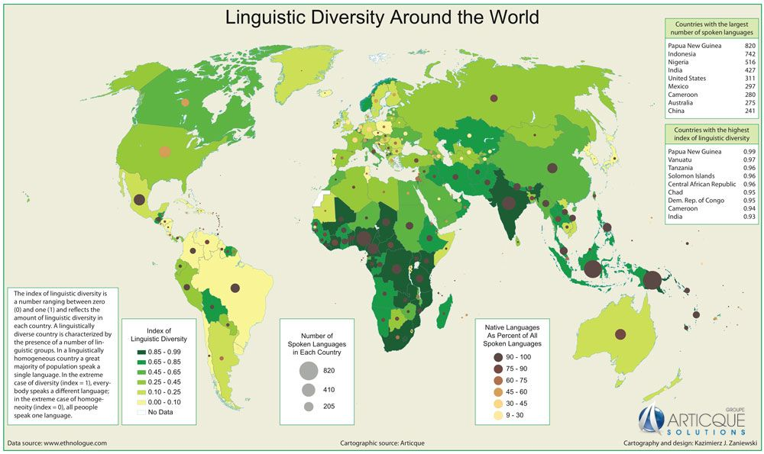
The reality of Bilingualism
DARKER GREEN
=
MORE LANGUAGES

Slide 3

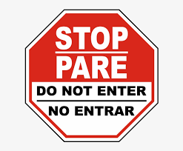
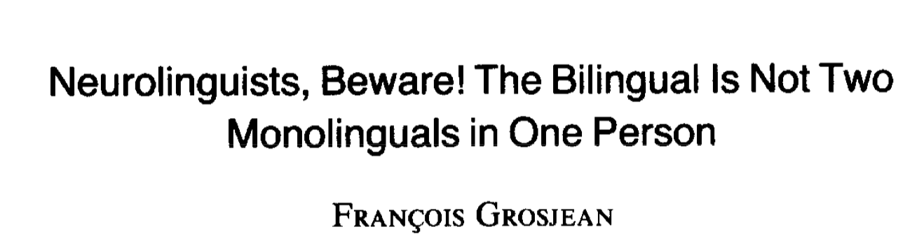
WHO IS A BILINGUAL
Historically, research has largely focused on studying bilingualism as a dichotic trait.

Slide 4
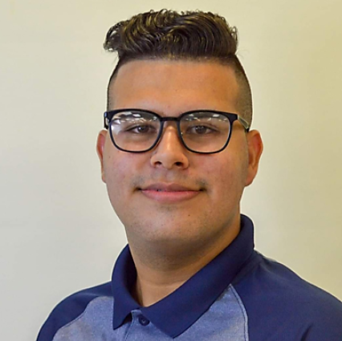
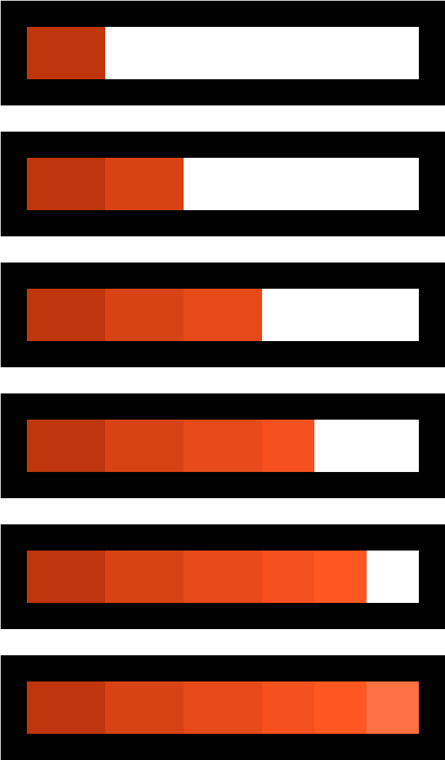
  Reinaldo: Learned to speak Spanish at home in Cuba, some Russian at school in Cuba, then lived in Galicia (Spain) where he was exposed to Galician and Castilian Spanish. At 16 moved to the US learning English.
Language identity
Bilingual social network
Late AoA
Pluriculturality
Language immersion
Formal language training

Slide 5
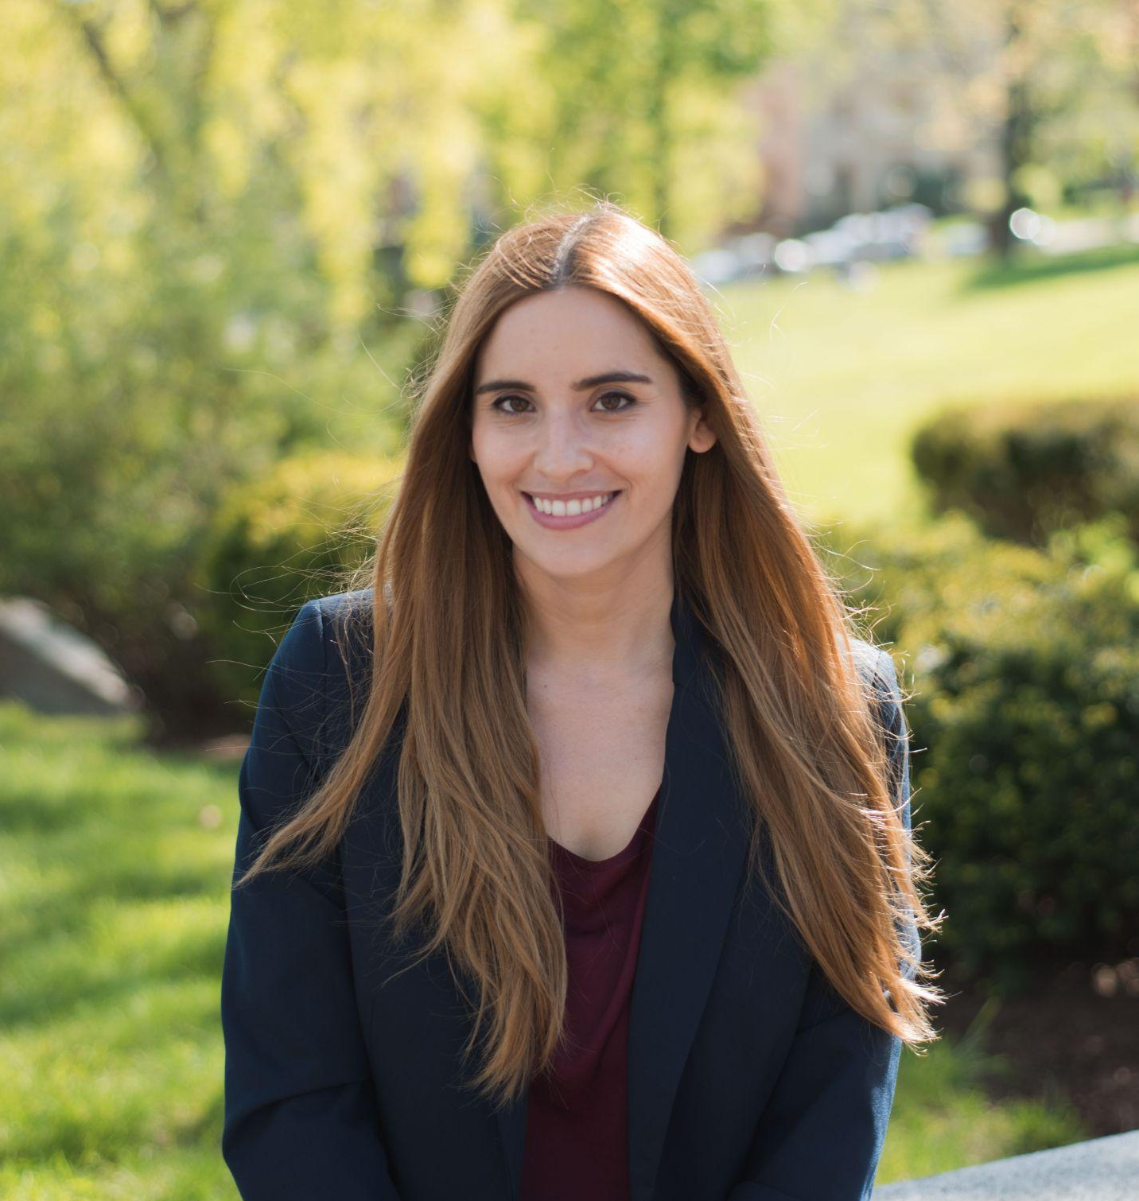
  Ester: Learned to speak Spanish at home in Spain, learned English as an L2 in Spain, then moved to the US, where she learned Italian.
Language identity
Bilingual social network
Late AoA
Pluriculturality
Language immersion
Formal language training

Slide 6
Individual Cognitive abilities
Proficiency
L1/L2/LX
Age of acquisition
OUTCOMES
INDIVIDUAL
Language/Code-switching
Individual neural variability
Linguistic adaptation
Mode of acquisition
Neurocognitive adaptation
Social norms
Language use in individual’s personal social network
ENVIRONMENT
SOCIAL
Social
adaptation
Environmental language use
In different contexts
TIME

Slide 7
Individual Cognitive abilities
Proficiency
L1/L2/LX
Age of acquisition
OUTCOMES
INDIVIDUAL
Language/Code-switching
Individual neural variability
Linguistic adaptation
Mode of acquisition
Language use in individual’s personal social network
Neurocognitive adaptation
Social norms
ENVIRONMENT
SOCIAL
Social
adaptation
Environmental language use
In different contexts
TIME

Slide 8
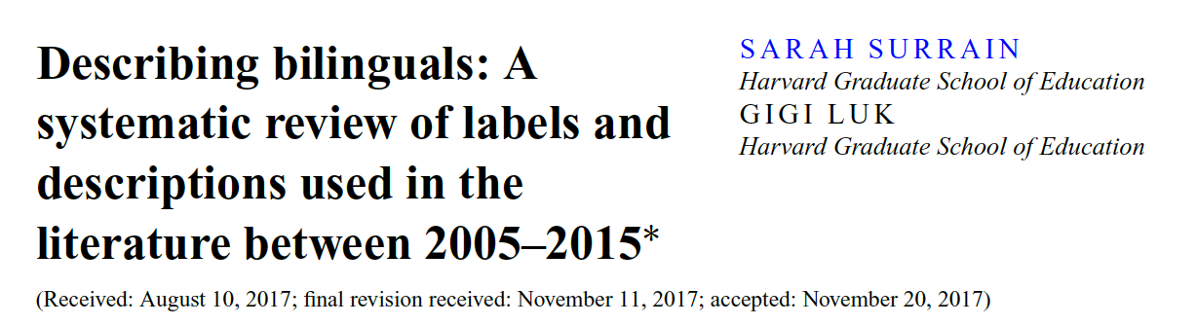
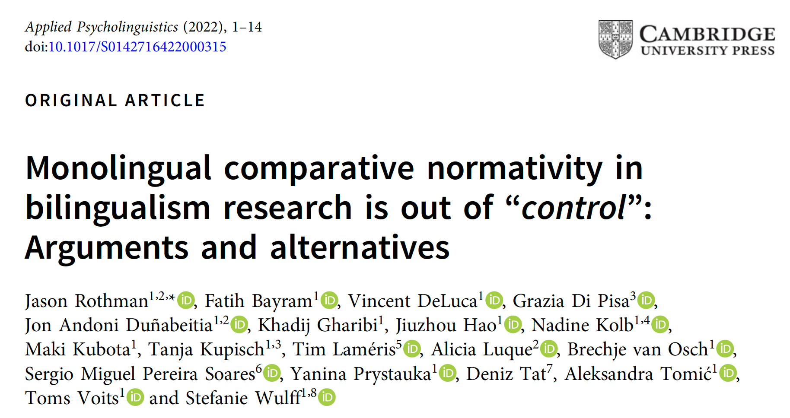
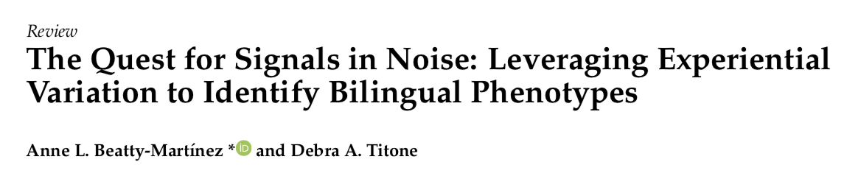
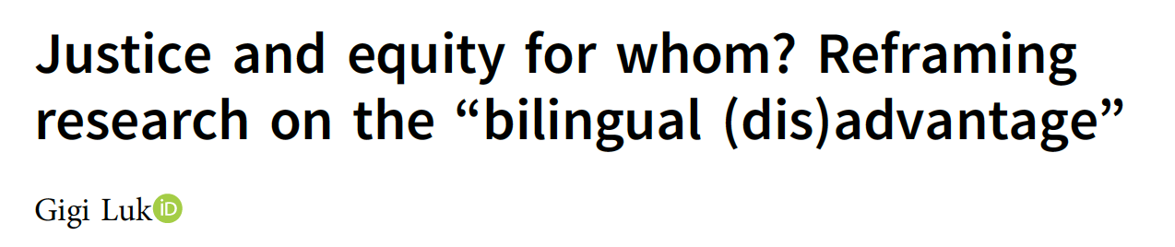
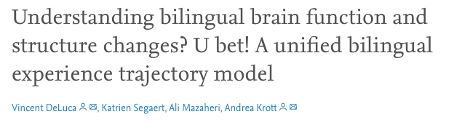
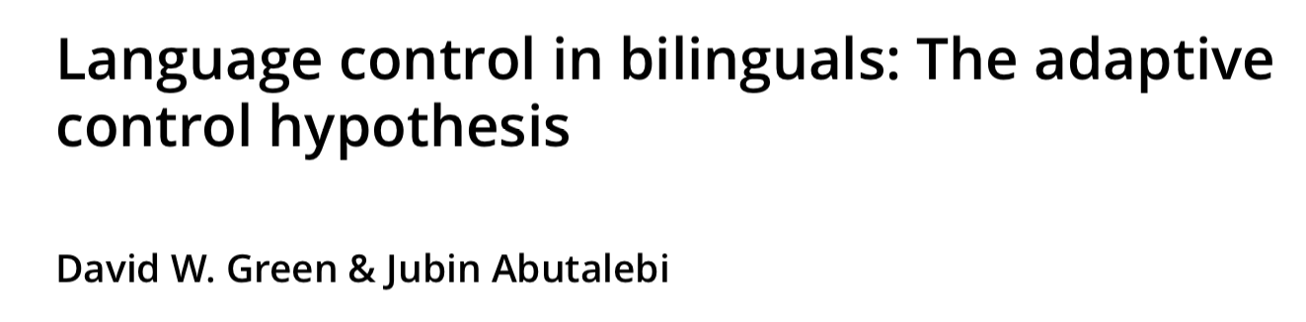

Slide 9
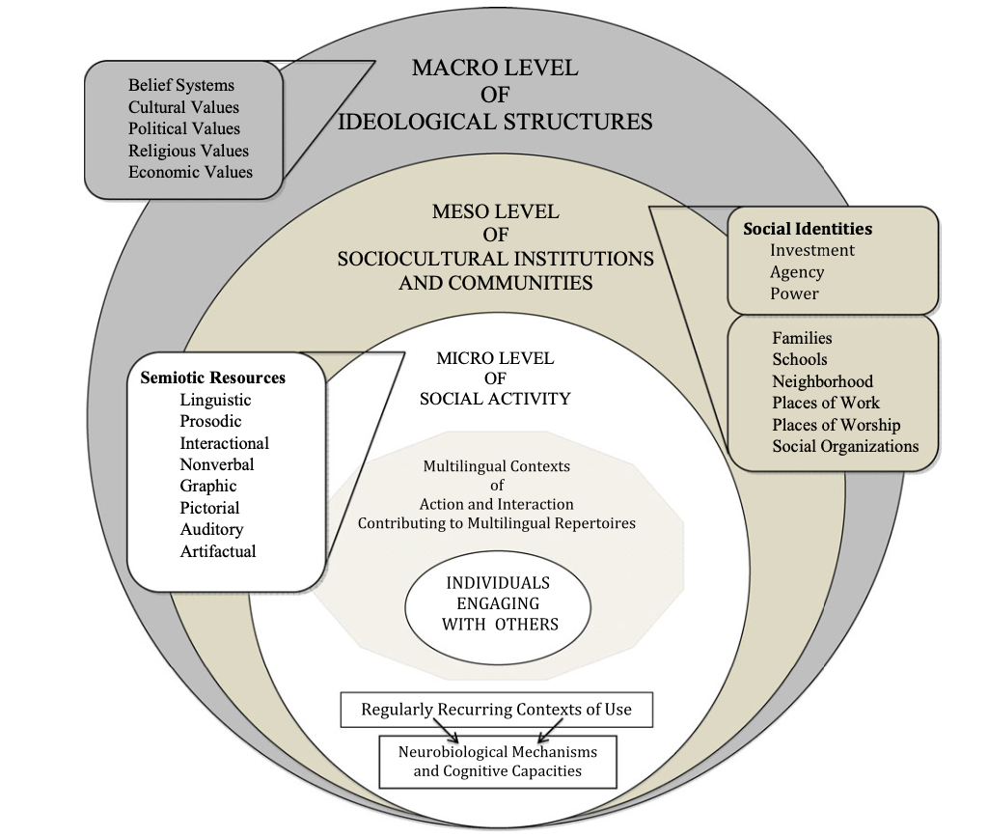
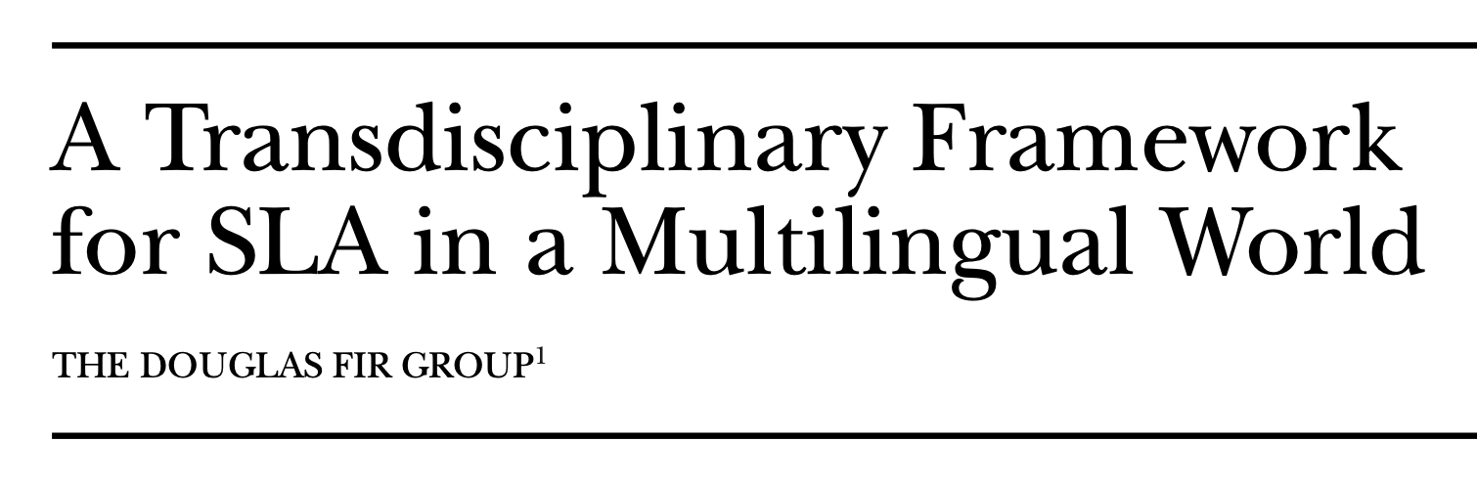
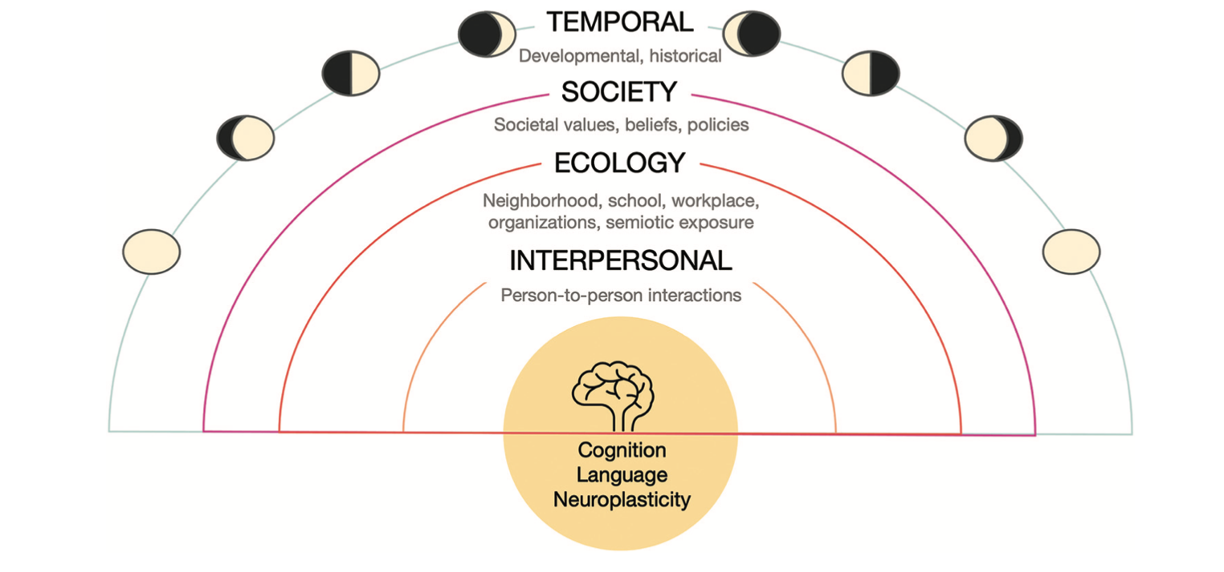
A system framework for bilingualism (Tiv et al., (2022)

Slide 10
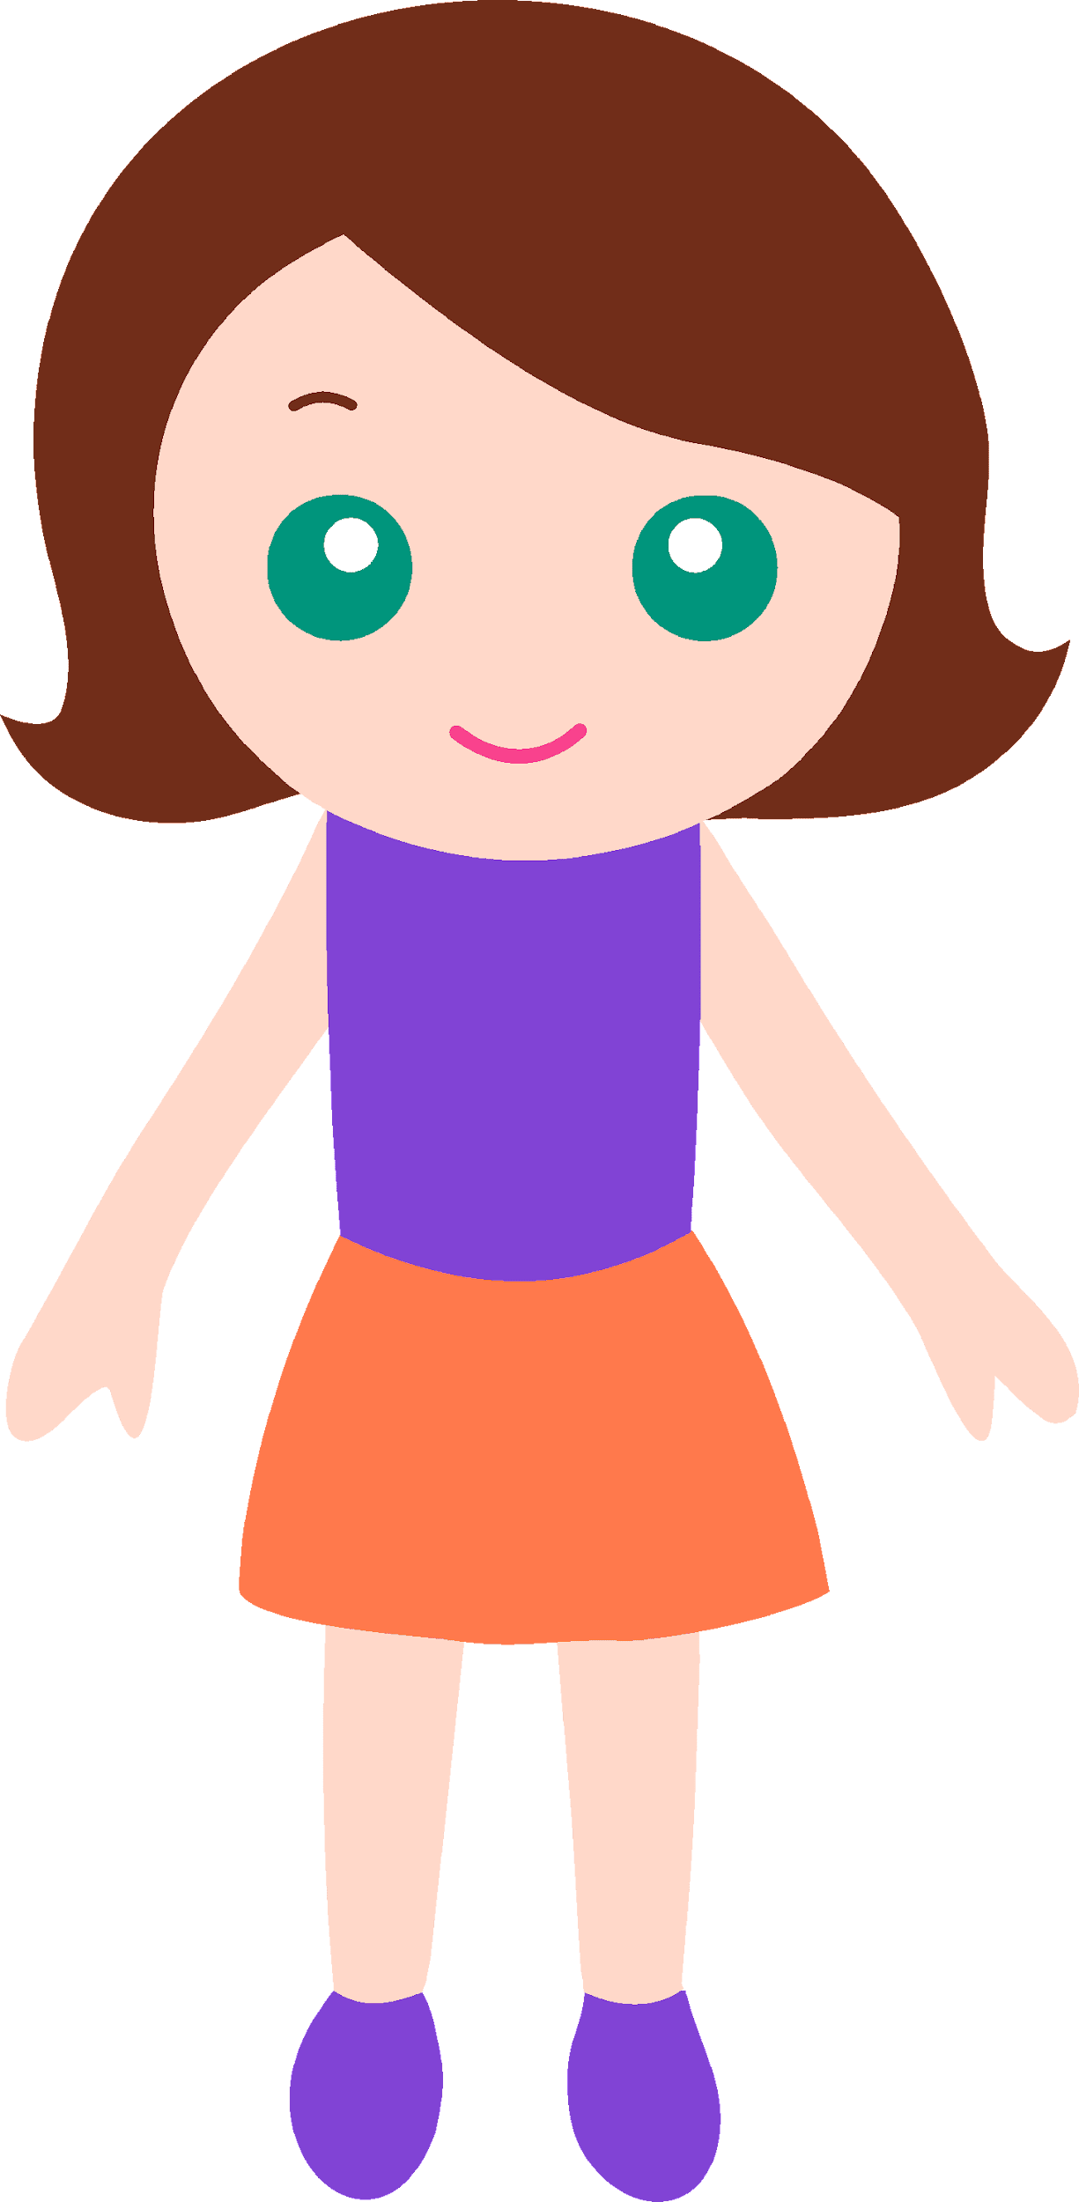
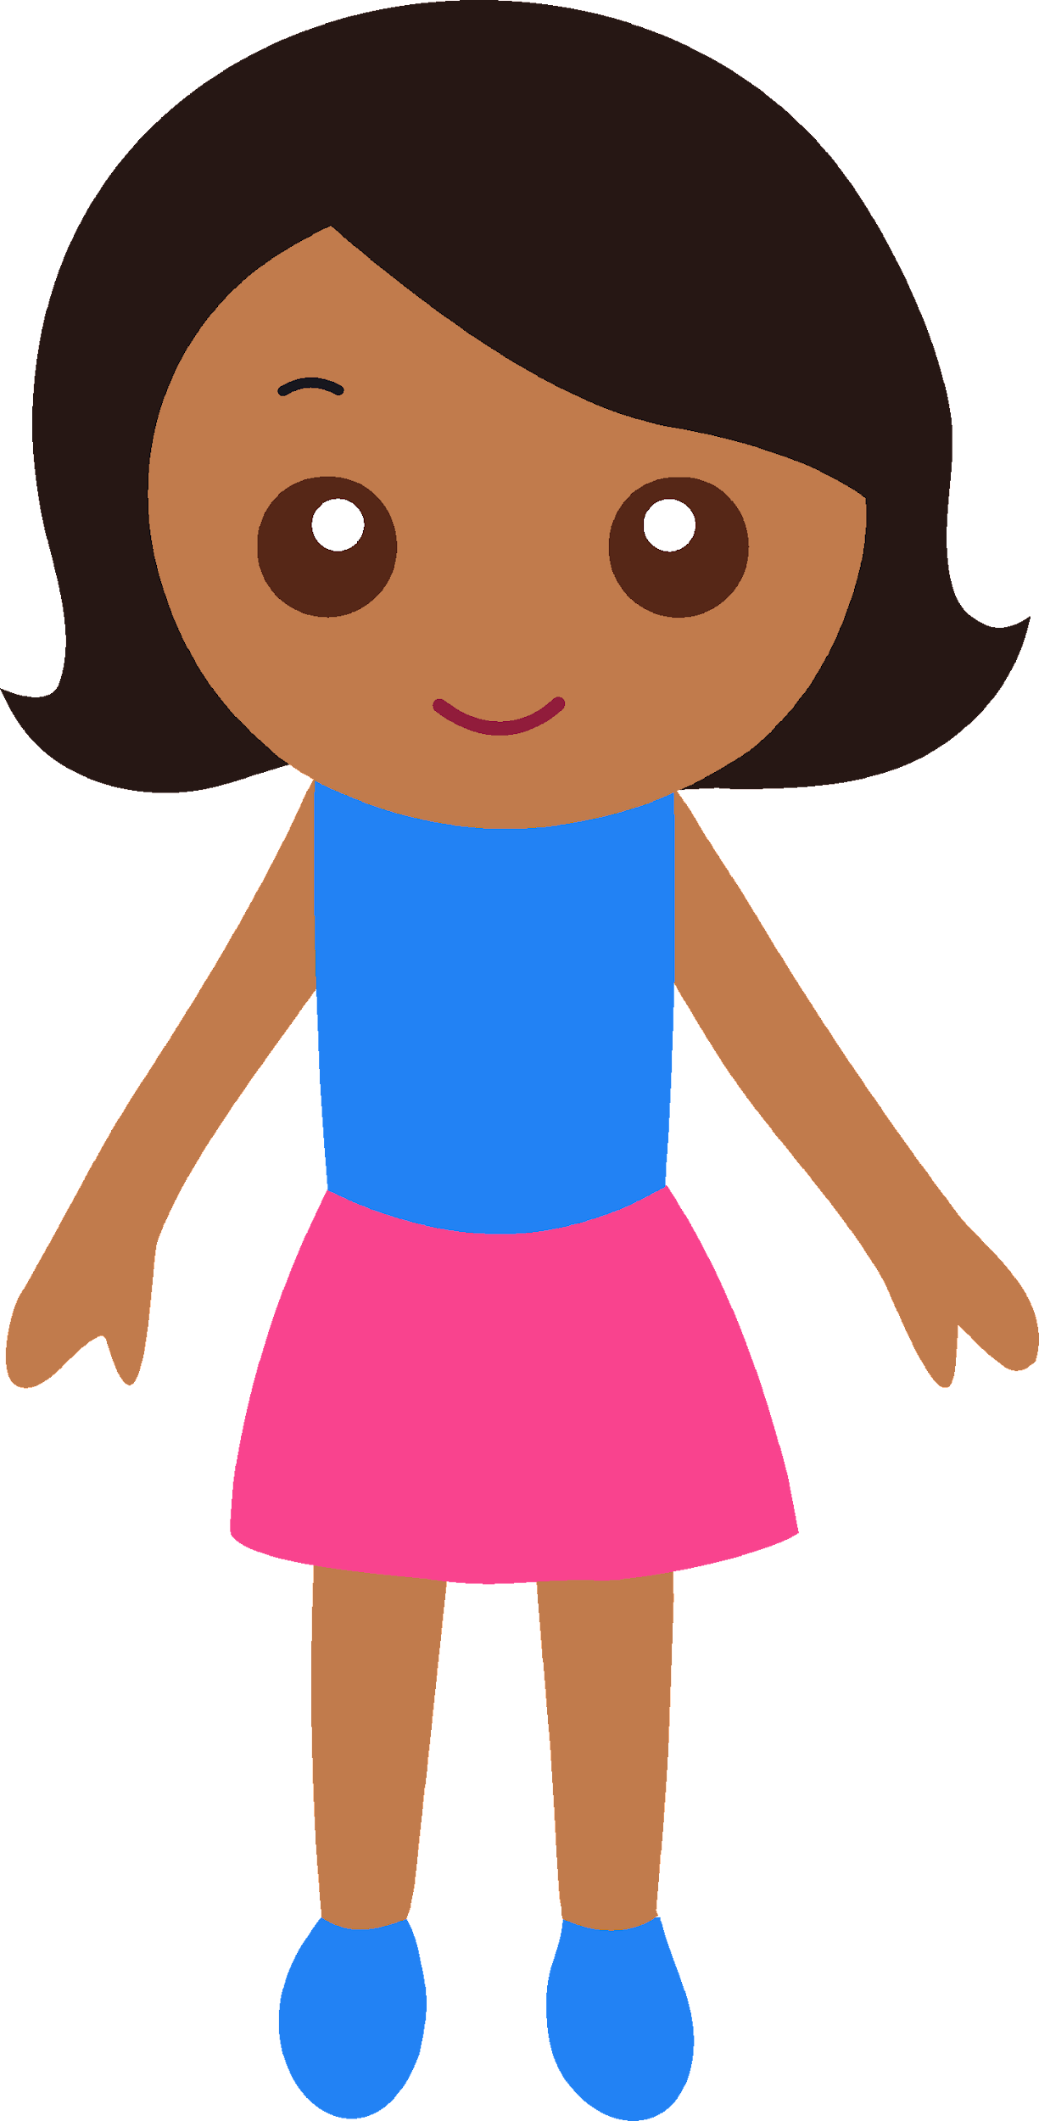
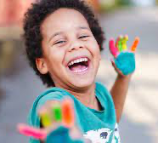
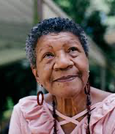
Bi-lingual language use of the individual
Methods
Changes in the life-span
From childhood
to older adulthood
Social Network analysis
Quantitative methods
Psychometric methods
Structural properties of the Social Network

Slide 11
Structural and compositional properties of the speaker’s Personal Social Network
Linguistic performance an adaptation
Neurocognitive performance and adaptation
To describe the variability of the phenomenon “BILINGUALISM”

Slide 12
Structural and compositional properties of the speaker’s Personal Social Network
Rossi et al., in prep
Navarro, DeLuca & Rossi, 2021
Navarro & Rossi, Under review
Linguistic performance an adaptation
Neurocognitive performance and adaptation
Describe the variability of the phenomenon “BILINGUALISM”

Slide 13
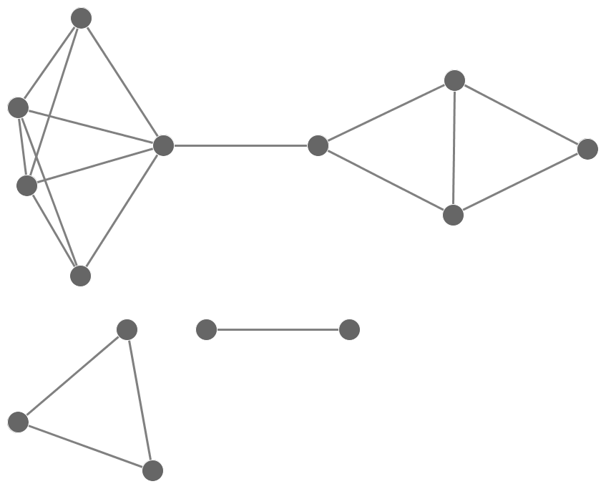
WHAT IS A PERSONAL SOCIAL NETWORK?
A social network is a set of actors and ties
Nodes/Vertices/Actors/Ego
Actors who can establish relations with each other
Individuals
Households
Companies
Countries
…
Slide kindly provided by Dr. Raffaele Vacca @ UF

Slide 14
Links/Edges/Ties
Any kind of relation/interaction that may exist among actors
A is friends with B
A works with B
A sent emails to B
A had sex with B
A retweeted B
…
Assumption: Individual’s outcomes are influenced by direct contacts in different social contexts and connectivity between those contacts
Slide kindly provided by Dr. Raffaele Vacca @ UF

Slide 15

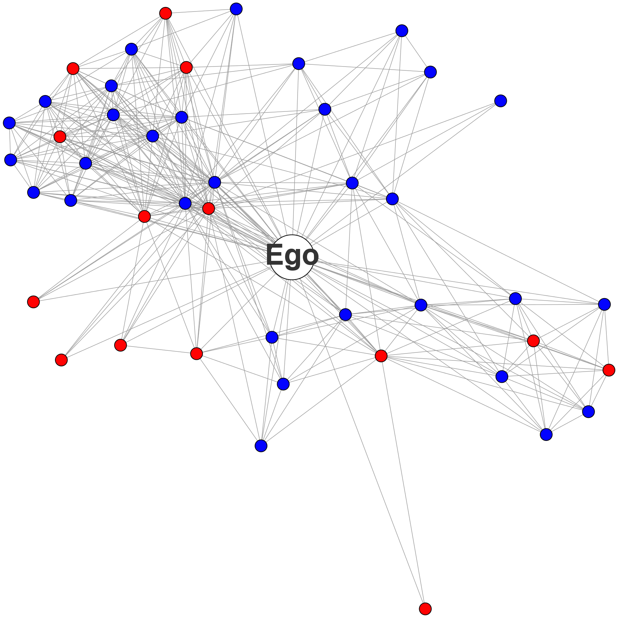
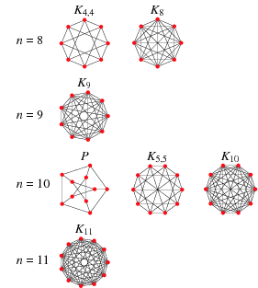
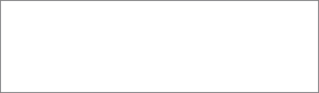
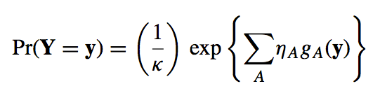
Nodes (alters) are all actors linked to a central ego (no boundary)
Ties are all relations (of a given type) among those actors
Data about relationships
 | Keith | Donna | Michael | Floyd | Michelle | Dwayne | Cora
Keith | 0 | 0 | 5 | 0 | 0 | 0 | 0
Donna | 0 | 0 | 0 | 3 | 1 | 0 | 4
Michael | 5 | 0 | 0 | 0 | 0 | 0 | 0
Floyd | 0 | 3 | 0 | 0 | 1 | 0 | 1
Michelle | 0 | 1 | 0 | 1 | 0 | 0 | 2
Dwayne | 0 | 0 | 0 | 0 | 0 | 0 | 1
Cora | 0 | 4 | 0 | 1 | 2 | 1 | 0
Mary | 0 | 3 | 0 | 0 | 0 | 0 | 0
Wendell | 0 | 2 | 0 | 5 | 0 | 0 | 0
Darryl | 0 | 1 | 0 | 0 | 0 | 0 | 0
Gregg | 1 | 1 | 0 | 1 | 1 | 0 | 1
Elmer | 0 | 3 | 0 | 0 | 0 | 0 | 0
Rebecca | 0 | 1 | 0 | 1 | 1 | 0 | 1
Meghan | 0 | 1 | 0 | 1 | 1 | 0 | 1
Janis | 0 | 1 | 0 | 1 | 0 | 0 | 0
➠
➠
Alter
Statistical models
Slide kindly provided by Dr. Raffaele Vacca @ UF

Slide 16
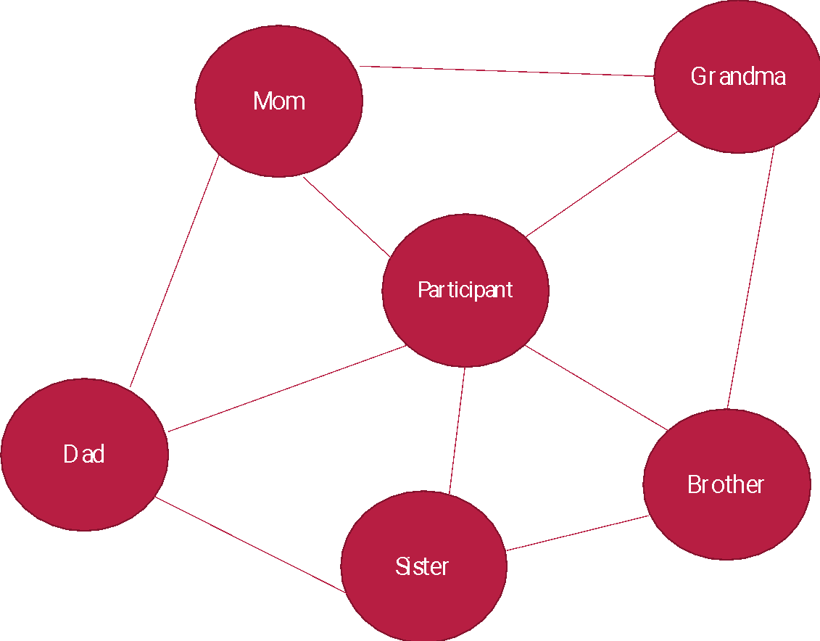
SOCIAL NETWORK
5 FAMILY MEMBERS
Ego level data
Ego-Alter level data
Alter-Alter level ties data
* Current and childhood experience

Slide 17
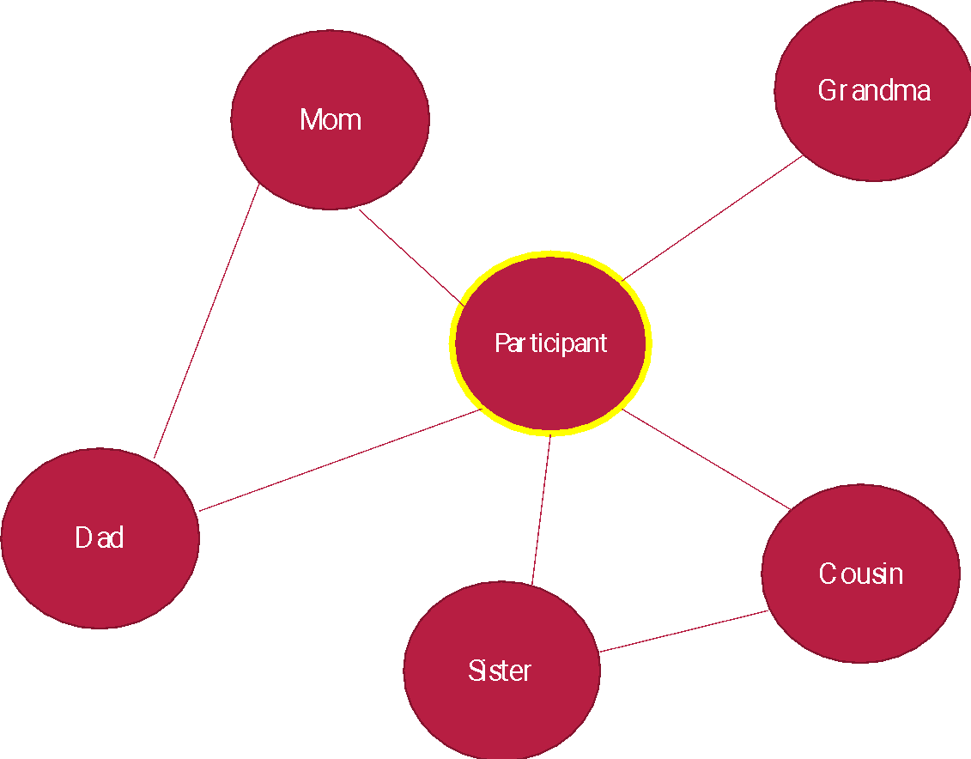
SOCIAL NETWORK
5 FAMILY MEMBERS
Ego level data
Ego-Alter level data
Alter-Alter level ties data
* Current and childhood experience

Slide 18
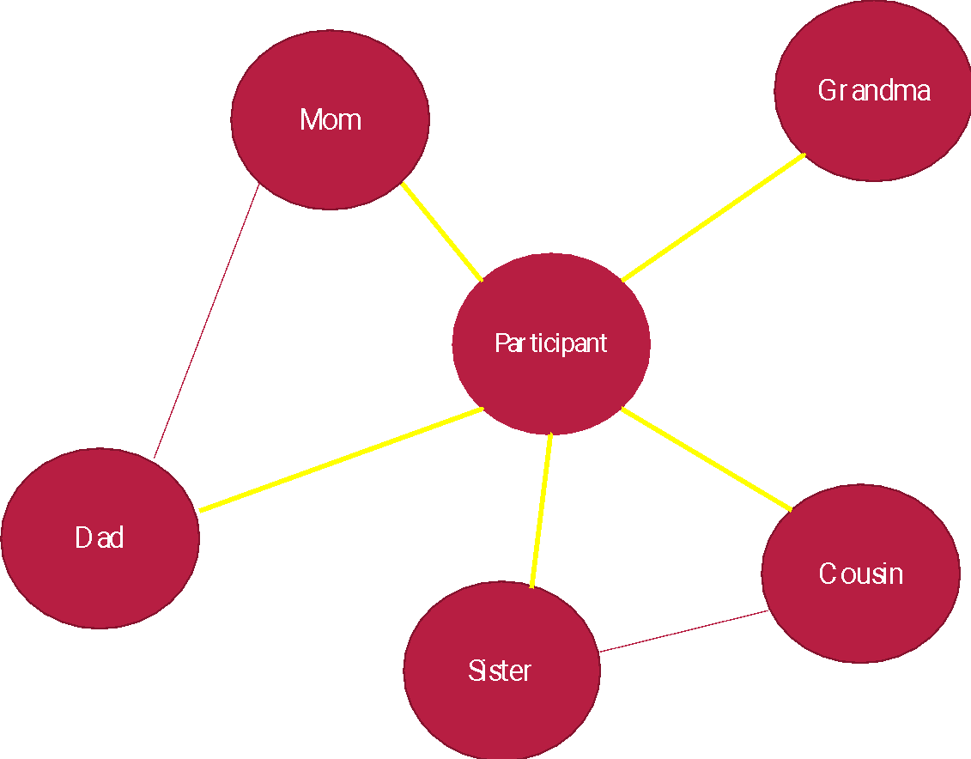
SOCIAL NETWORK
5 FAMILY MEMBERS
Ego level data
Ego-Alter level data
Alter-Alter level ties data
* Current and childhood experience

Slide 19
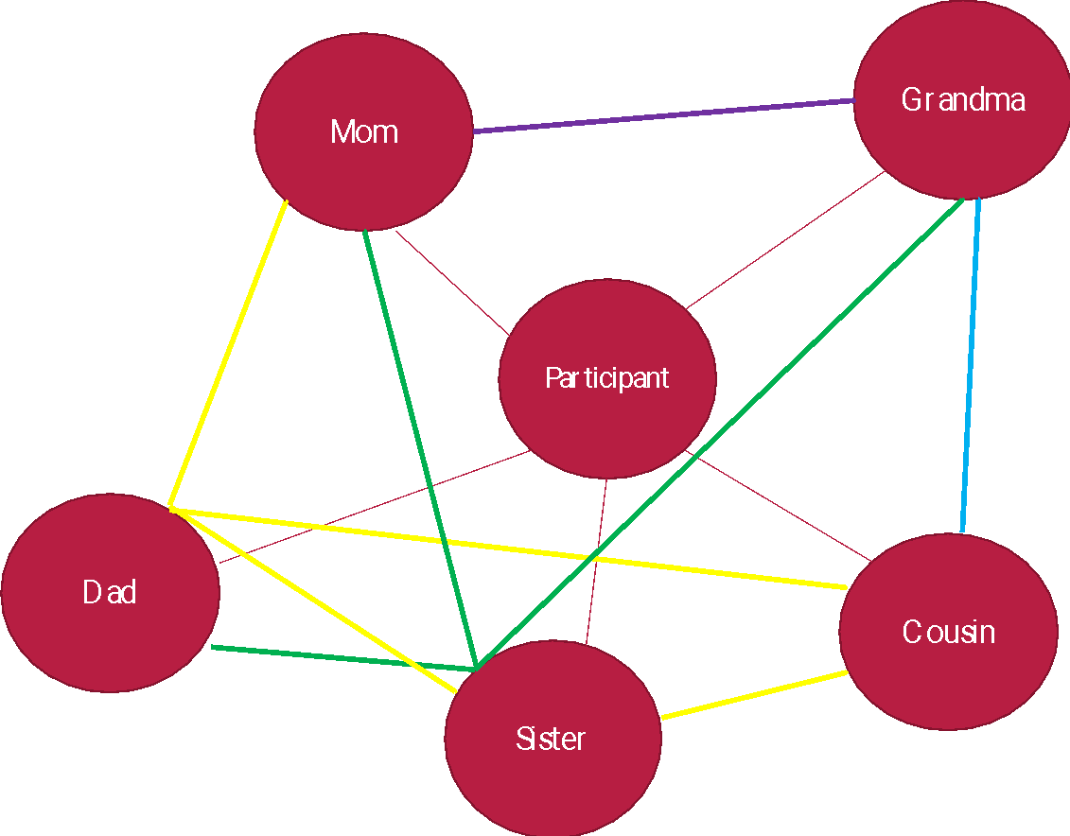
SOCIAL NETWORK
5 FAMILY MEMBERS
Ego level data
Ego-Alter level data
Alter-Alter level ties data
* Current and childhood experience

Slide 20

Study 1
Social Network Approaches to capture variability across the Lifespan and its consequences for cognition
Rossi et al., in preparation

Slide 21
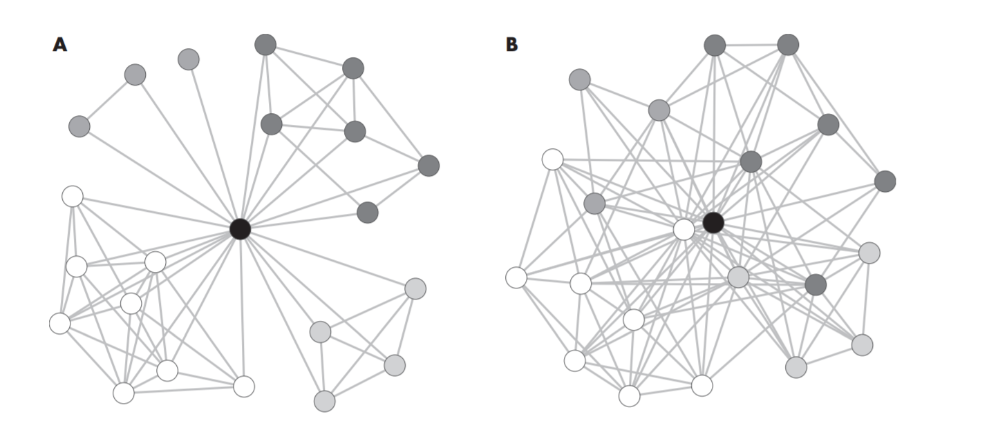
If and how structural and compositional social network in bilinguals modulate variability in cognitive performance.
Capture how bilinguals' language use changes over time.
Vacca et al. (2018)

Slide 22
SAMPLE
50 Spanish-English heritage speakers recruited from highly bilingual US states (California, Florida, New Mexico, Texas). Acquired both languages (English/Spanish) before the age of seven.
Track the social network for Spanish-English heritage speakers in the US, across the lifespan
  0 - 13 years old, 14 years old – today
Social network analysis to study bilingual variability
  This is a new approach since bilinguals are not static

Slide 23
INDIVIDUAL AND PERSONAL SOCIAL NETWORK
Social network interview via Egoweb software via virtual Zoom meeting with participant (2.5-3 hours long).
-Extensive LHQ (Ego data)
-Ego nominated 15 alters for the early part of life with whom they communicated regularly (5 family members, 5 friends, 5 schoolmates)
-Ego responded to a series of questions on alters and alter-alter language behavior.
-The interview replicated for the second part of life

Slide 24
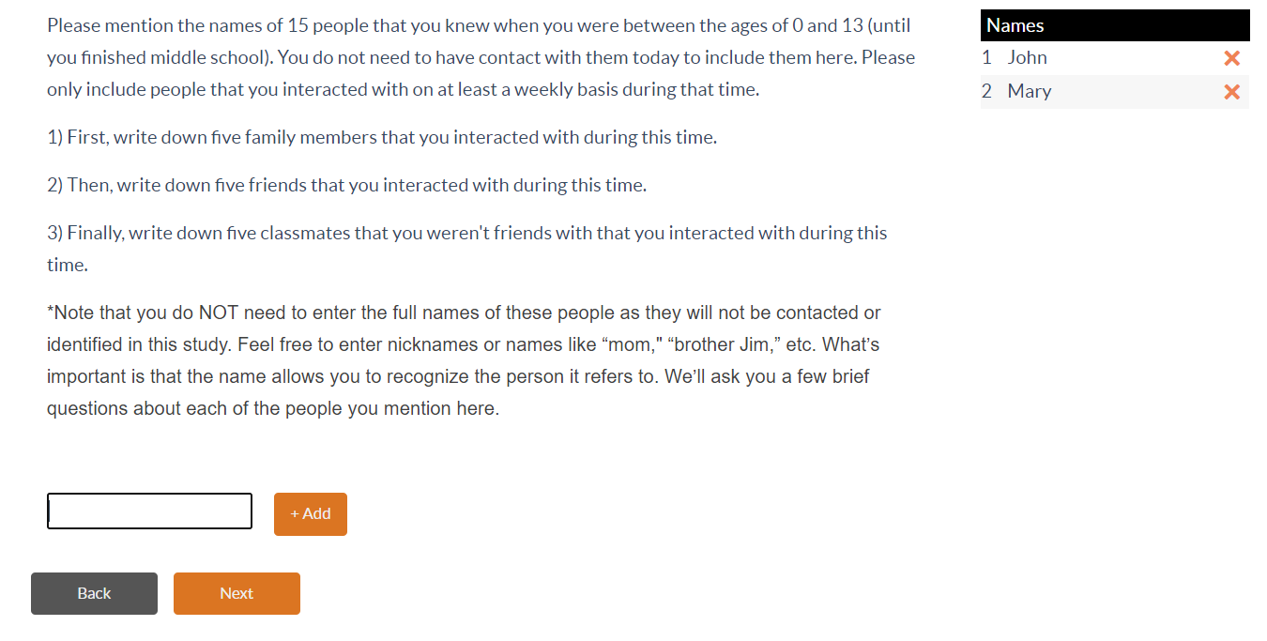
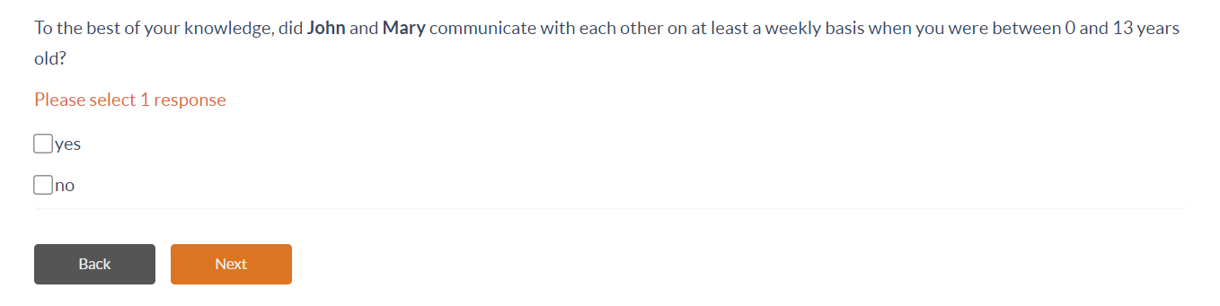

Slide 25
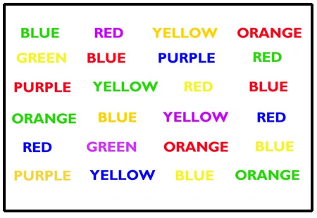
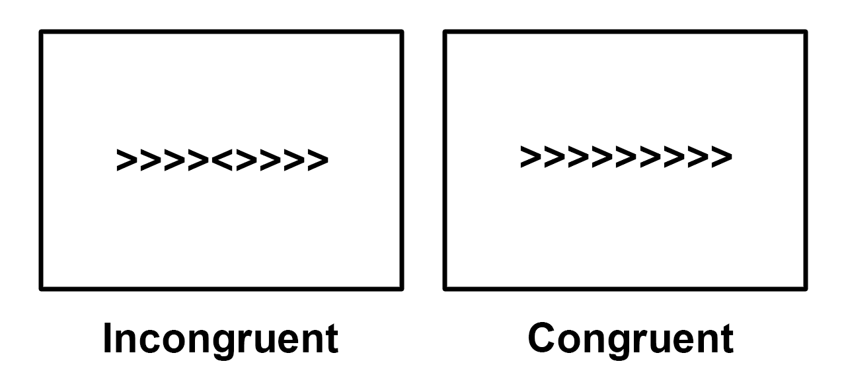
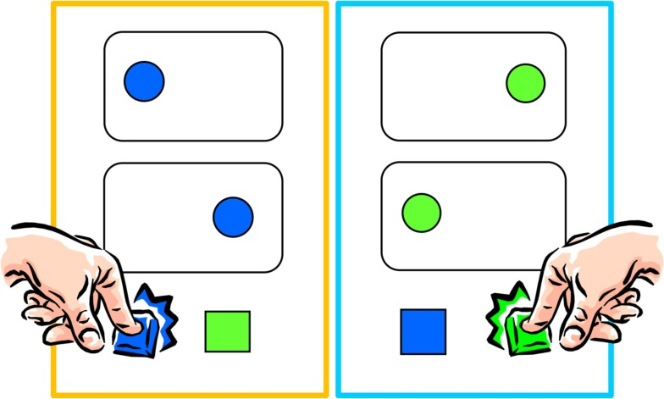
COGNITIVE MEASURES
Participants completed three cognitive control tasks (Tatool software (Von Bastian et al., 2013)
  Stroop Flanker Simon

Slide 26
ANALYSIS
DENSITY
BETWEENNESS
LANGUAGE ENTROPY
Higher density =>
higher language use with the ego in the network
General measure of centrality:
Higher scores for betweenness => higher drivers of communication
Higher entropy => more complexity/variability in bilingual language use.

Slide 27
ANALYSIS
DENSITY
BETWEENNESS
LANGUAGE ENTROPY
SIMON TASK PERFORMANCE

Slide 28
ANALYSIS
DENSITY
BETWEENNESS
LANGUAGE ENTROPY
SIMON TASK PERFORMANCE
TIME (first part of life / second part of life)
CODE-SWITCHING BEVAHIOR (High / Medium low)

Slide 29
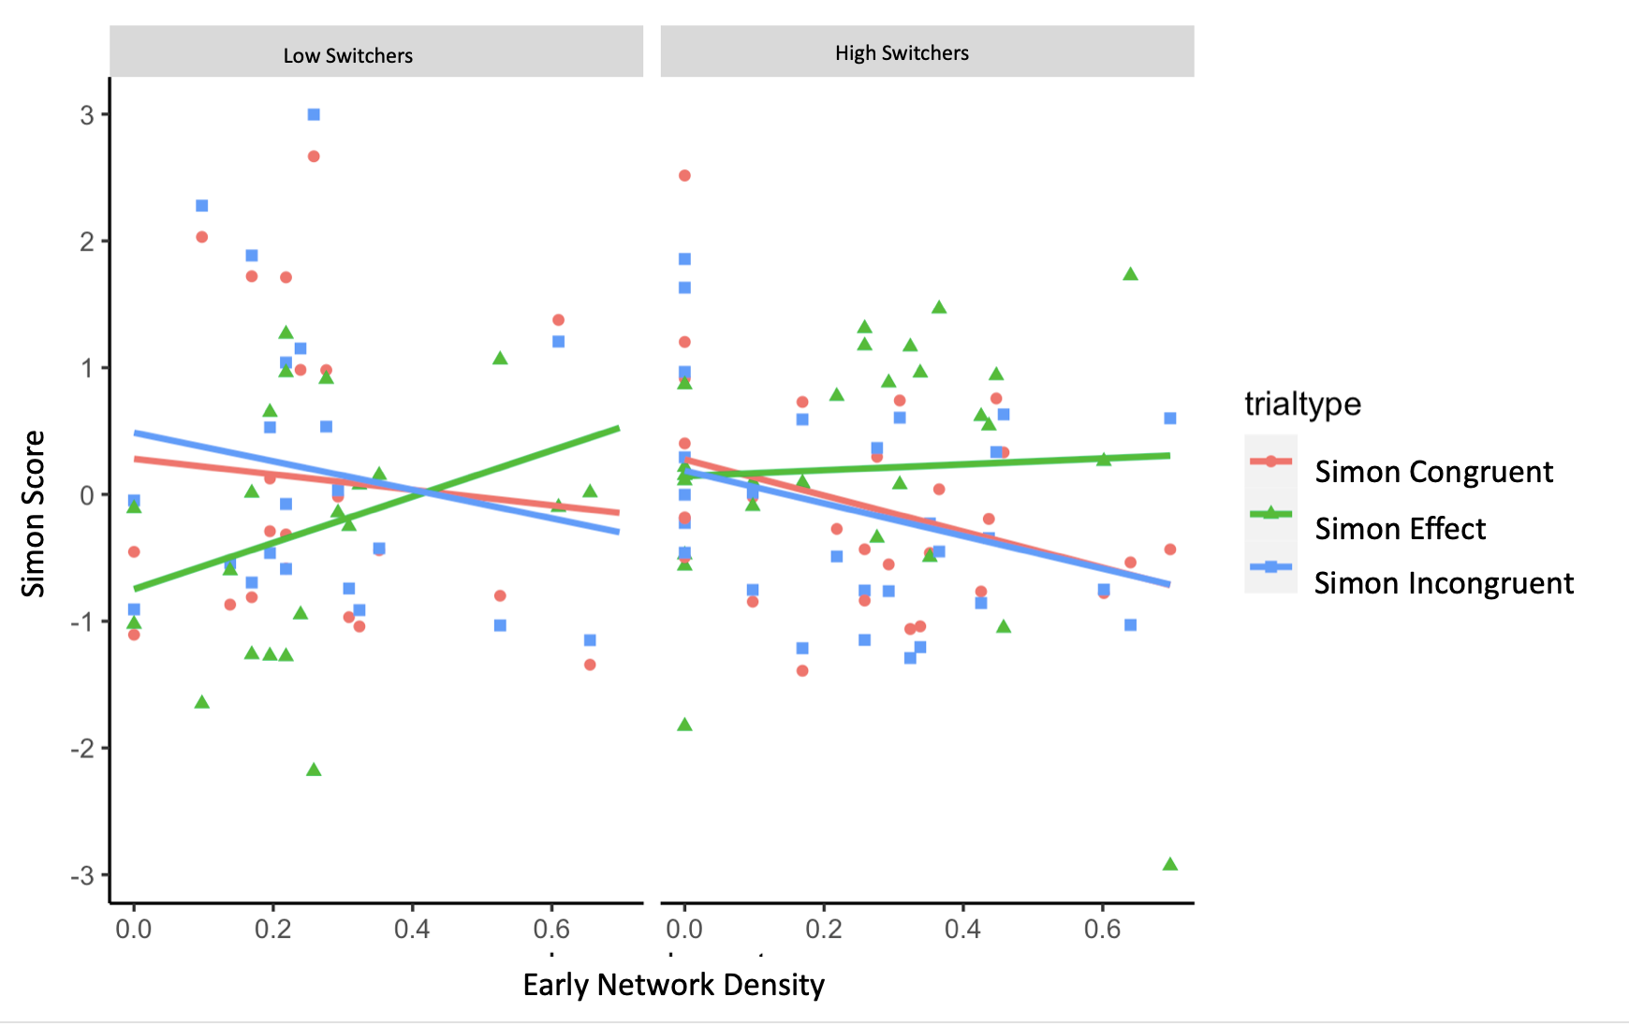
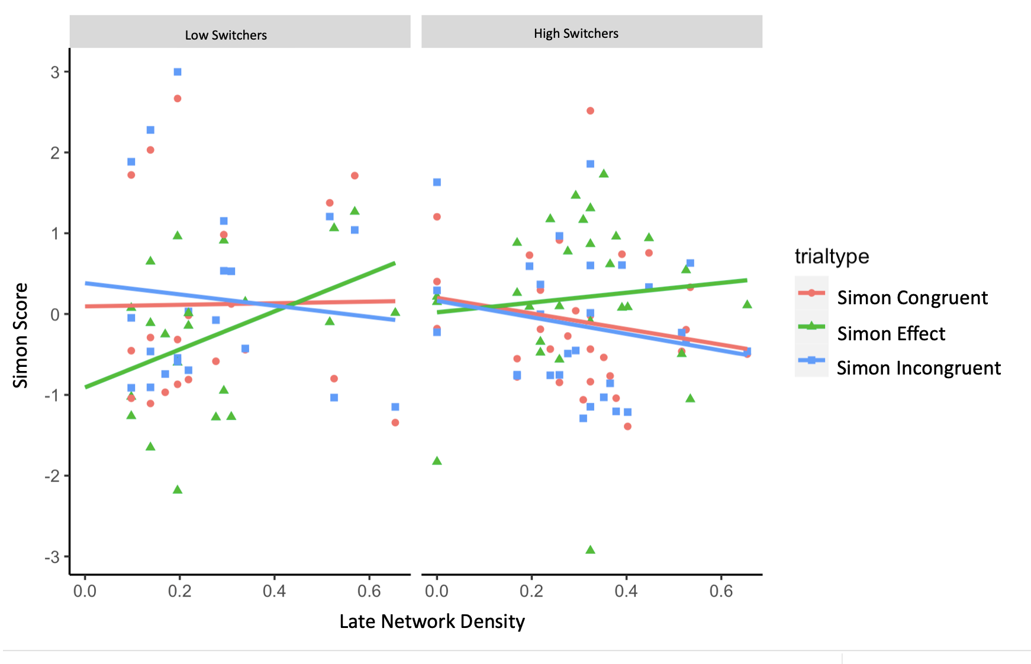
NETWORK DENSITY

Slide 30
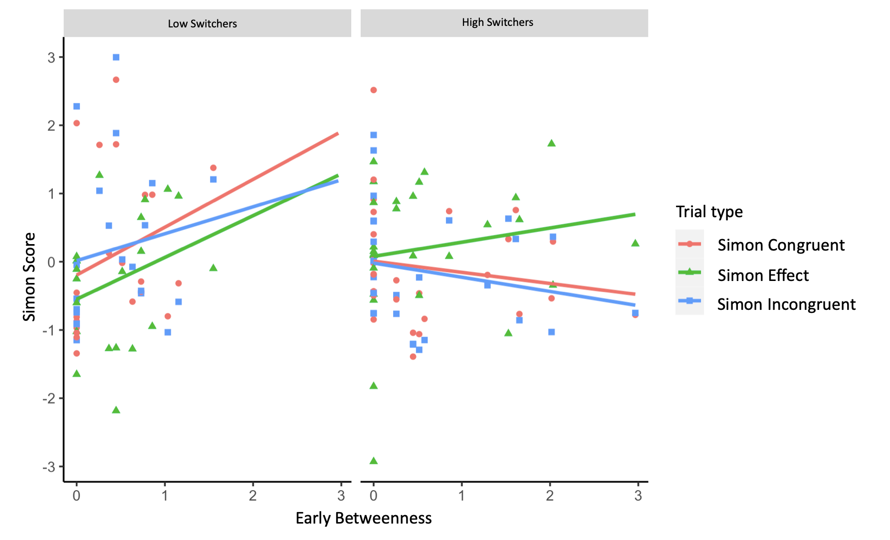
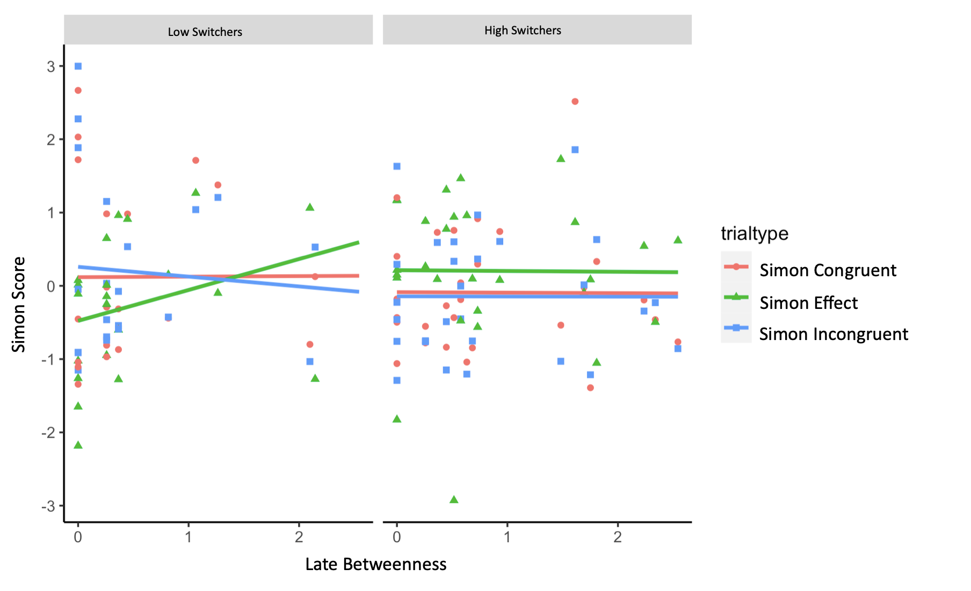
BETWEENNESS

Slide 31
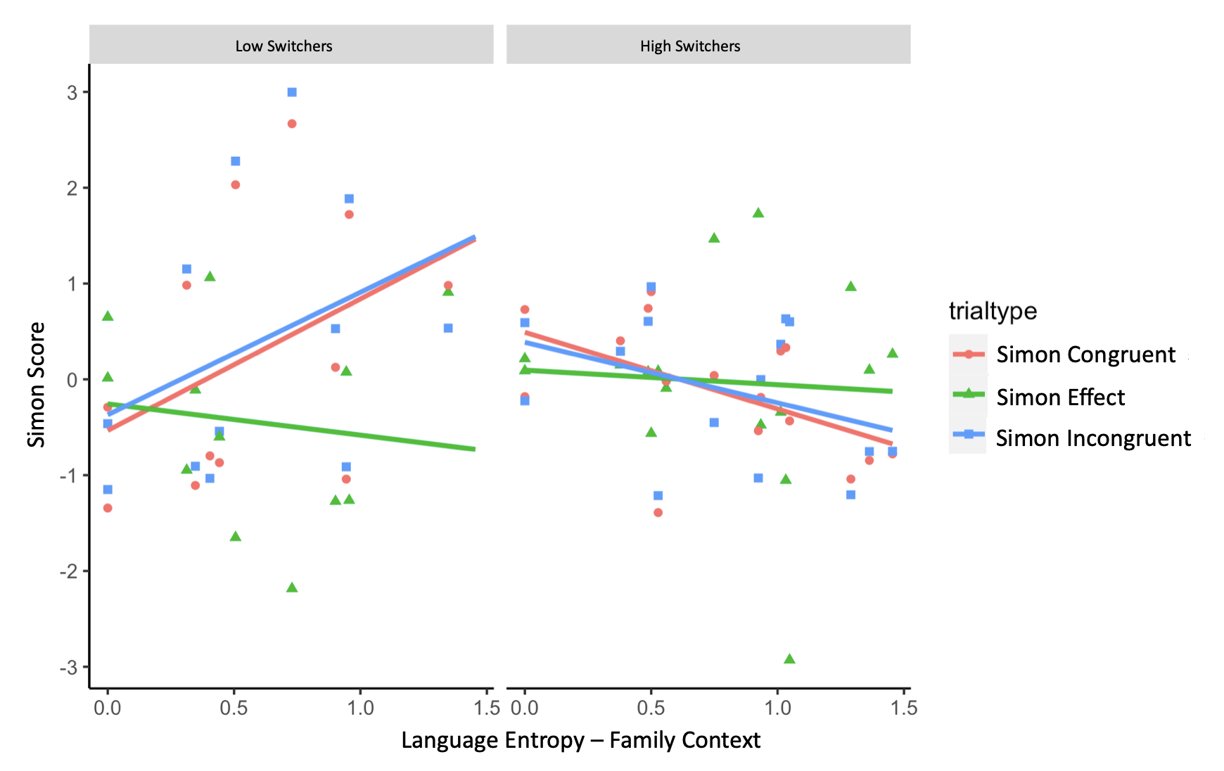
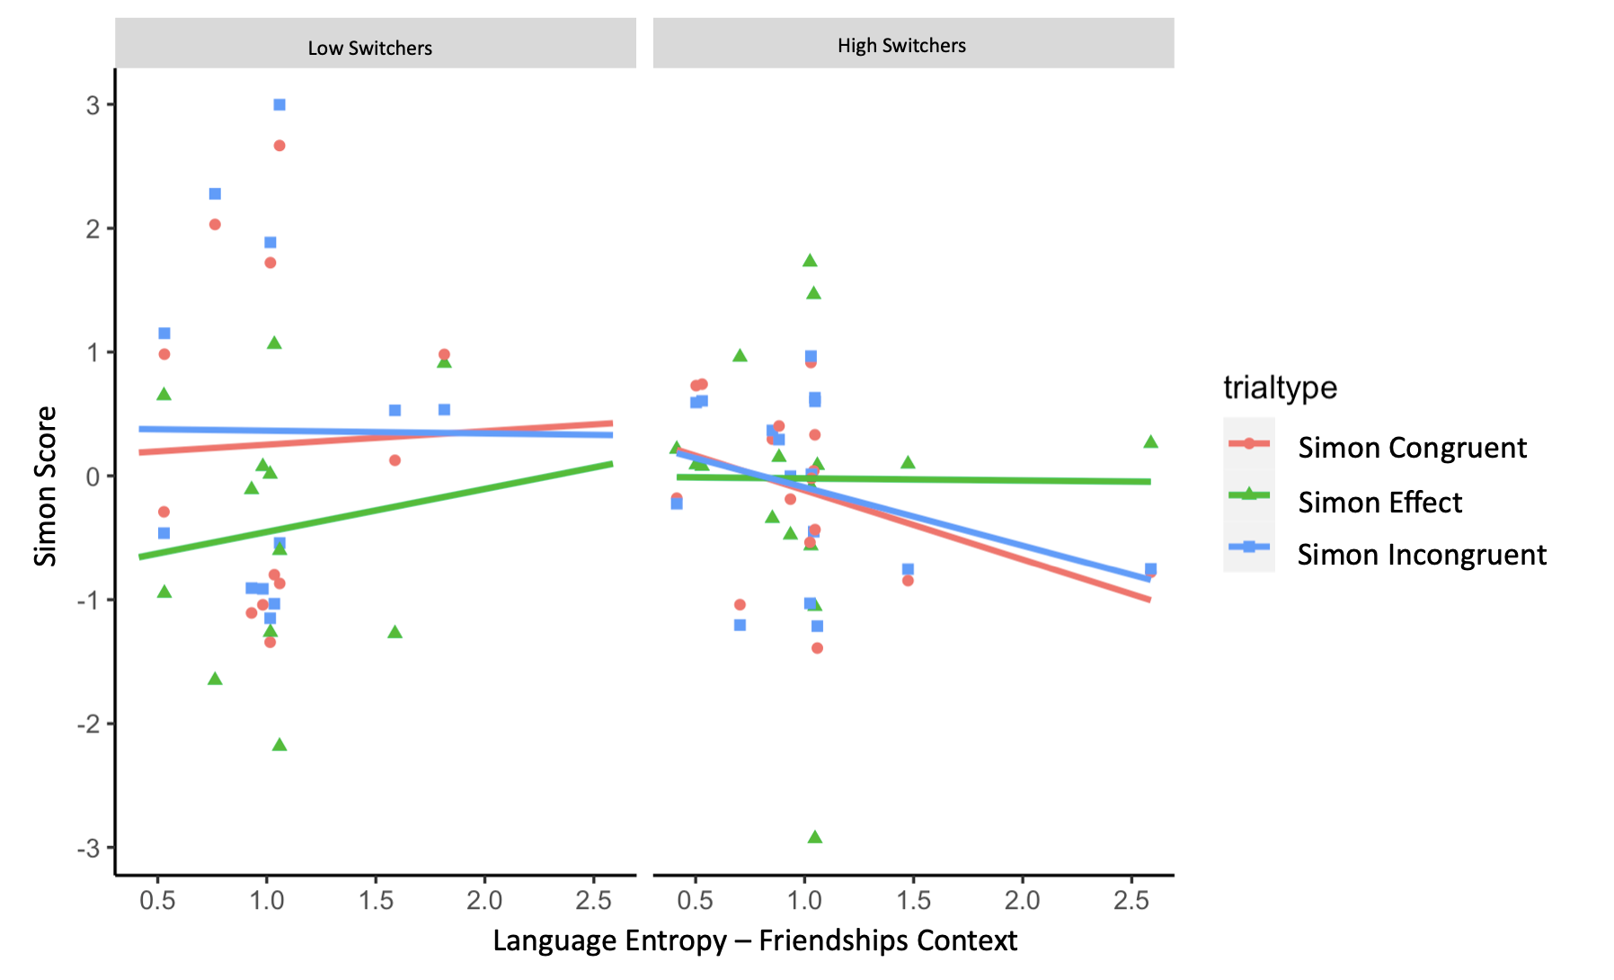
LANGUAGE ENTROPY

Slide 32
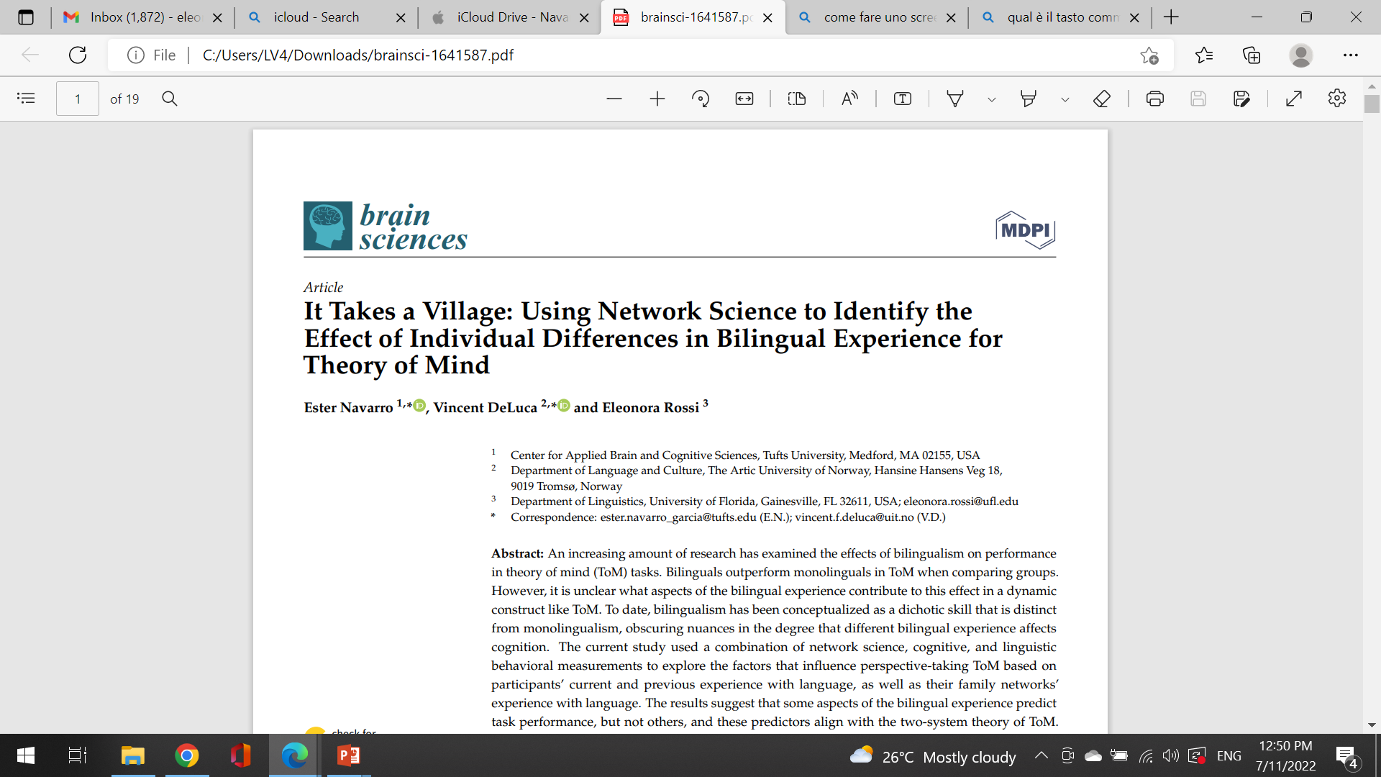
Study 2
Using Social Network Approaches and Individual differences in bilingual language experience as a modulator of Theory of Mind
Navarro, DeLuca & Rossi, 2021

Slide 33


THEORY OF MIND / TOM
The ability to infer others’ mental states. Essential for social competence and communication.
ToM ”kicks in” between the age of 3 and 4 years
ToM ability continues to improve and develop gradually throughout childhood, adolescence, and adulthood, suggesting variation in ToM performance.
Bilingual individuals (more so and earlier than monolingual children) have to understand that not everybody shares their linguistic competence

Slide 34
Bilingualism and ToM in children
    3- and 4-year-old bilingual children outperform their monolingual counterparts in ToM tasks (Goetz, 2003; Greenberg et al., 2013; Kovács, 2009; Schroeder, 2018).
    ToM differences in bilingual children have been connected to general differences in general cognitive performance (e.g., Bialystok & Senman, 2004) or to advanced metalinguistic awareness (the ability to reflect upon and manipulate language.
    Encountering people who do not speak one of the languages that a bilingual child can speak forces bilingual children to reflect on their knowledge of what other people know (and do not know) earlier than monolinguals, who do not encounter this problem (Kovács, 2009).

Slide 35
SAMPLE
  N = 89 (subset of Study 1) college students based in Southern California, Florida and Texas
LANGUAGE EXPERIENCE AND SOCIAL NETWORK MEASURES
  All the measures described in Study 1
  Online mouse tracking Perspective taking task (Director’s task) to measure part of the ToM construct
  Online metalinguistic task

Slide 36
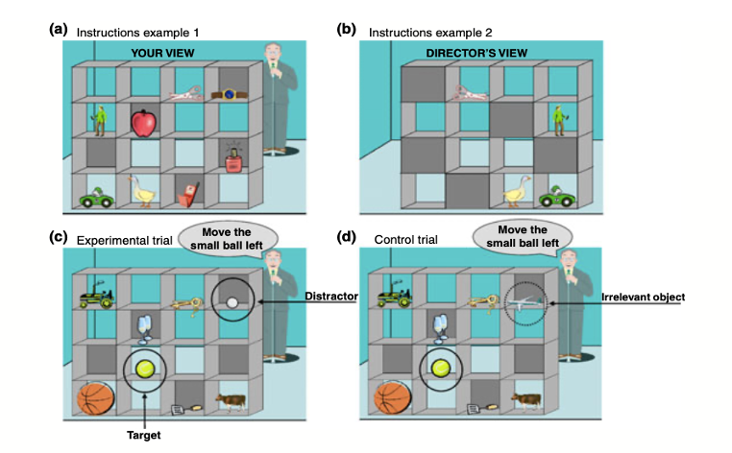

Slide 37
Significant predictors of the director’s task (perspective taking)
(p < 0.001) in the model
Mean L2 use
Ego switch
Alter-ties languages spoken during childhood

Slide 38
Study 3
Using Latent Variable Analysis to capture Variability in Bilingual Language Experience
(Navarro & Rossi, under review)

Slide 39
An exploratory approach to describing the components of bilingualism
We used latent factor analyses to examine whether bilingualism is better understood as a monolithic trait with multiple subcategories or if it is better defined by related but distinct aspects of language experience
MEASURES
  Language Experience and Proficiency Questionnaire (LEAP-Q; Marian, Blumenfeld, & Kaushanskaya, 2007)
  Language and Social Background Questionnaire (Anderson et al., 2018)
  Switching Questionnaire (Rodriguez-Fornells et al., 2012)
  Social network interview (based on method of McCarty et al. 2019)
    Communication, languages, switching tendencies, childhood (Rossi & Navarro, in prep)
    Duration ± 5-7 minutes
SAMPLE
  N = 222 college students based in Southern California, Florida and Texas
  All together: +100 variables

Slide 40
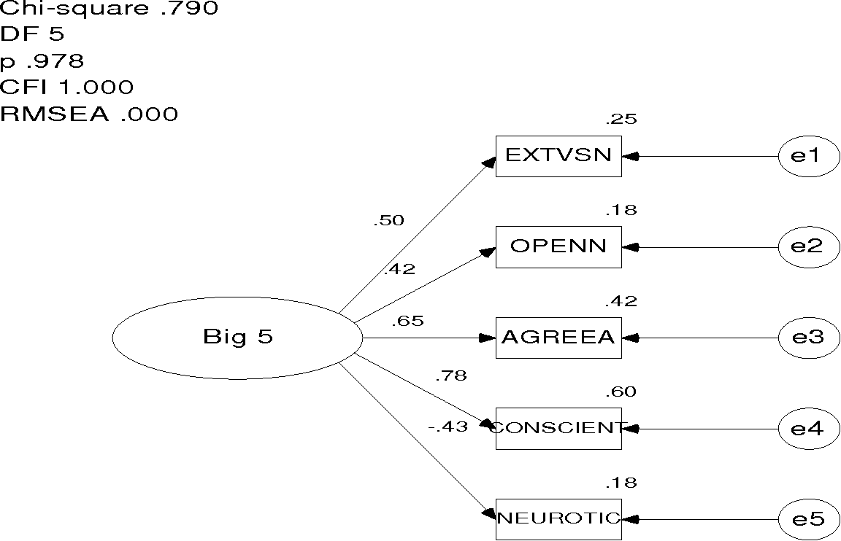
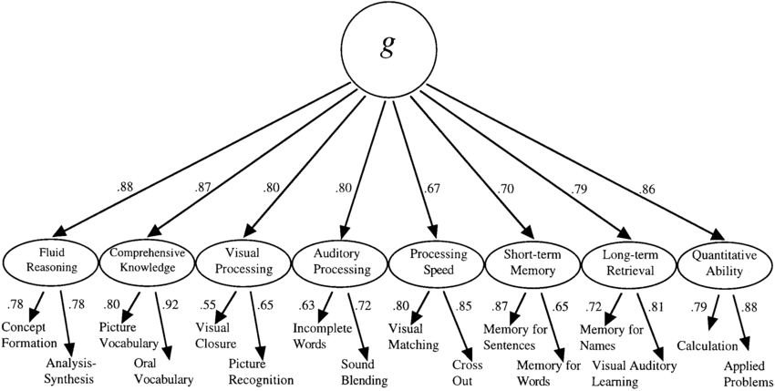
Latent Factor analysis
Statistical method used in psychometrics to examine whether multiple variables or tasks belong or are caused by the same underlying construct
Big 5
General Intelligence

Slide 41
Hierarchical model of Bilingualism vs
Bifactor model of Language-Experience
Social Network Language Use: NLU
  E.g., Alter’s communication with ego and each other, number of languages alters speak with the ego and each other…
Ego’s Average Language Use: LANGUSE
  Mean L1 and L2 use with family, coworkers, friends…
Close Childhood Language Environment: CCLE
  Social Network communication during childhood with close alters (1 and 2 Alters)
Extended Childhood Language Environment: ECLE
  Social Network communication during childhood with extended alters (3+ Alters)
Language Switching: LS
  Ego and networks language switching tendencies

Slide 42

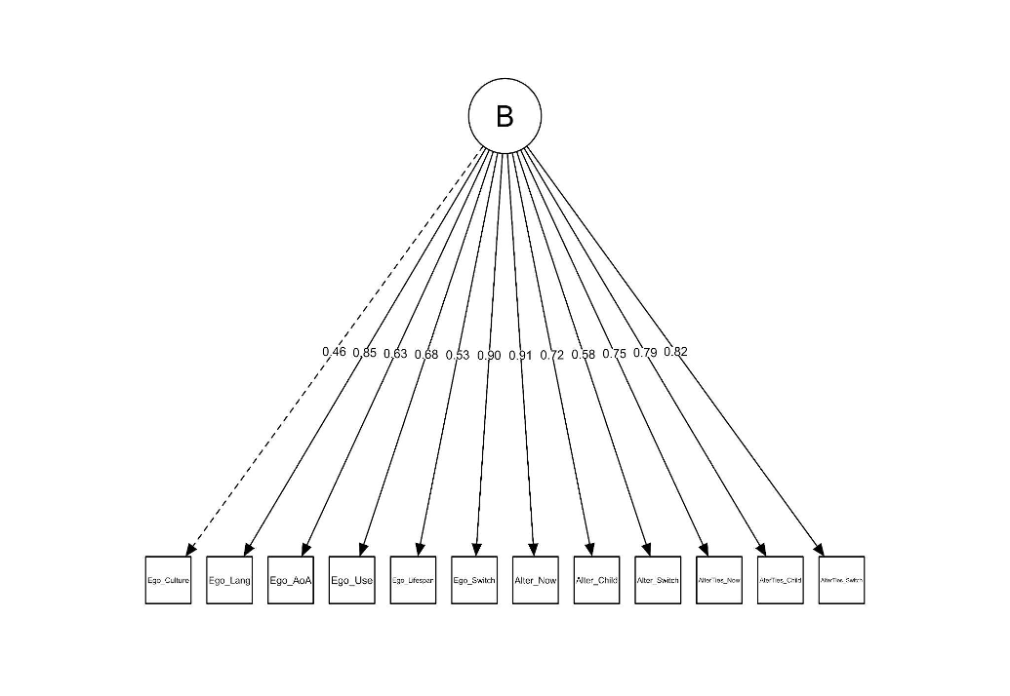
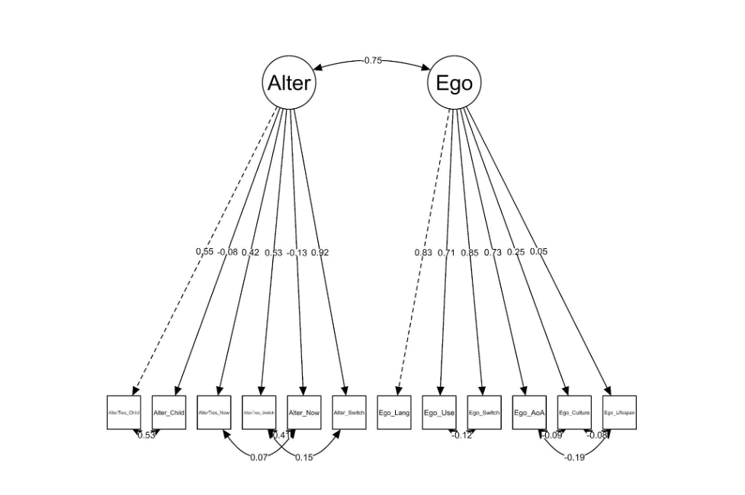

Slide 43
What did we learn?
Social network and psychometric science as valuable tool to better describe and capture variability in bilingual language experience
  At the individual level / at the community/network level
Implementing social network science to bilingual language research has the potential to cast causational ties between (bi)lingual language use and changes in social network and conversely, capture how changes in the social network might shape changes in (bi)lingual language use at the individual and at the community level.
Enables to better capture how changes (or lack thereof) in bilingual language use across the life-span might modulate and/predict linguistic and neurocognitive measures.
Fromm our psychometric models, we propose that bilingualism is better represented as a multifactor model of related but separate constructs of language experience and use.

Slide 44
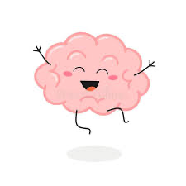
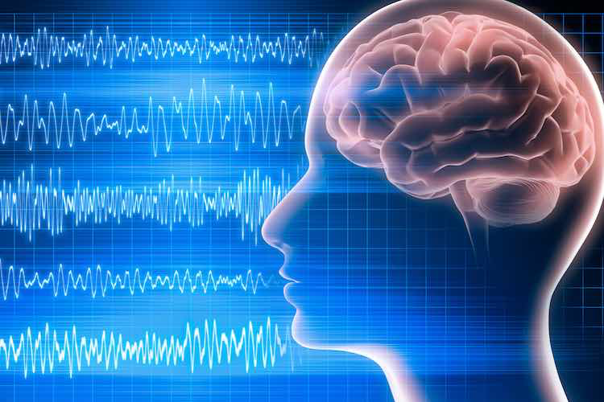
Future directions
Bi-lingual language use of the individual
Across the life-span
Bi-language use of the
network (beyond the individual
Predictive of cognitive and
brain (?) functioning.
EEG + TOM + SOCIAL NETWORK
Bilinguals/monolinguals

Slide 45
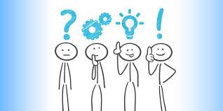

Thank you!

