Slide 1

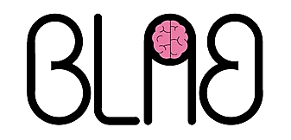
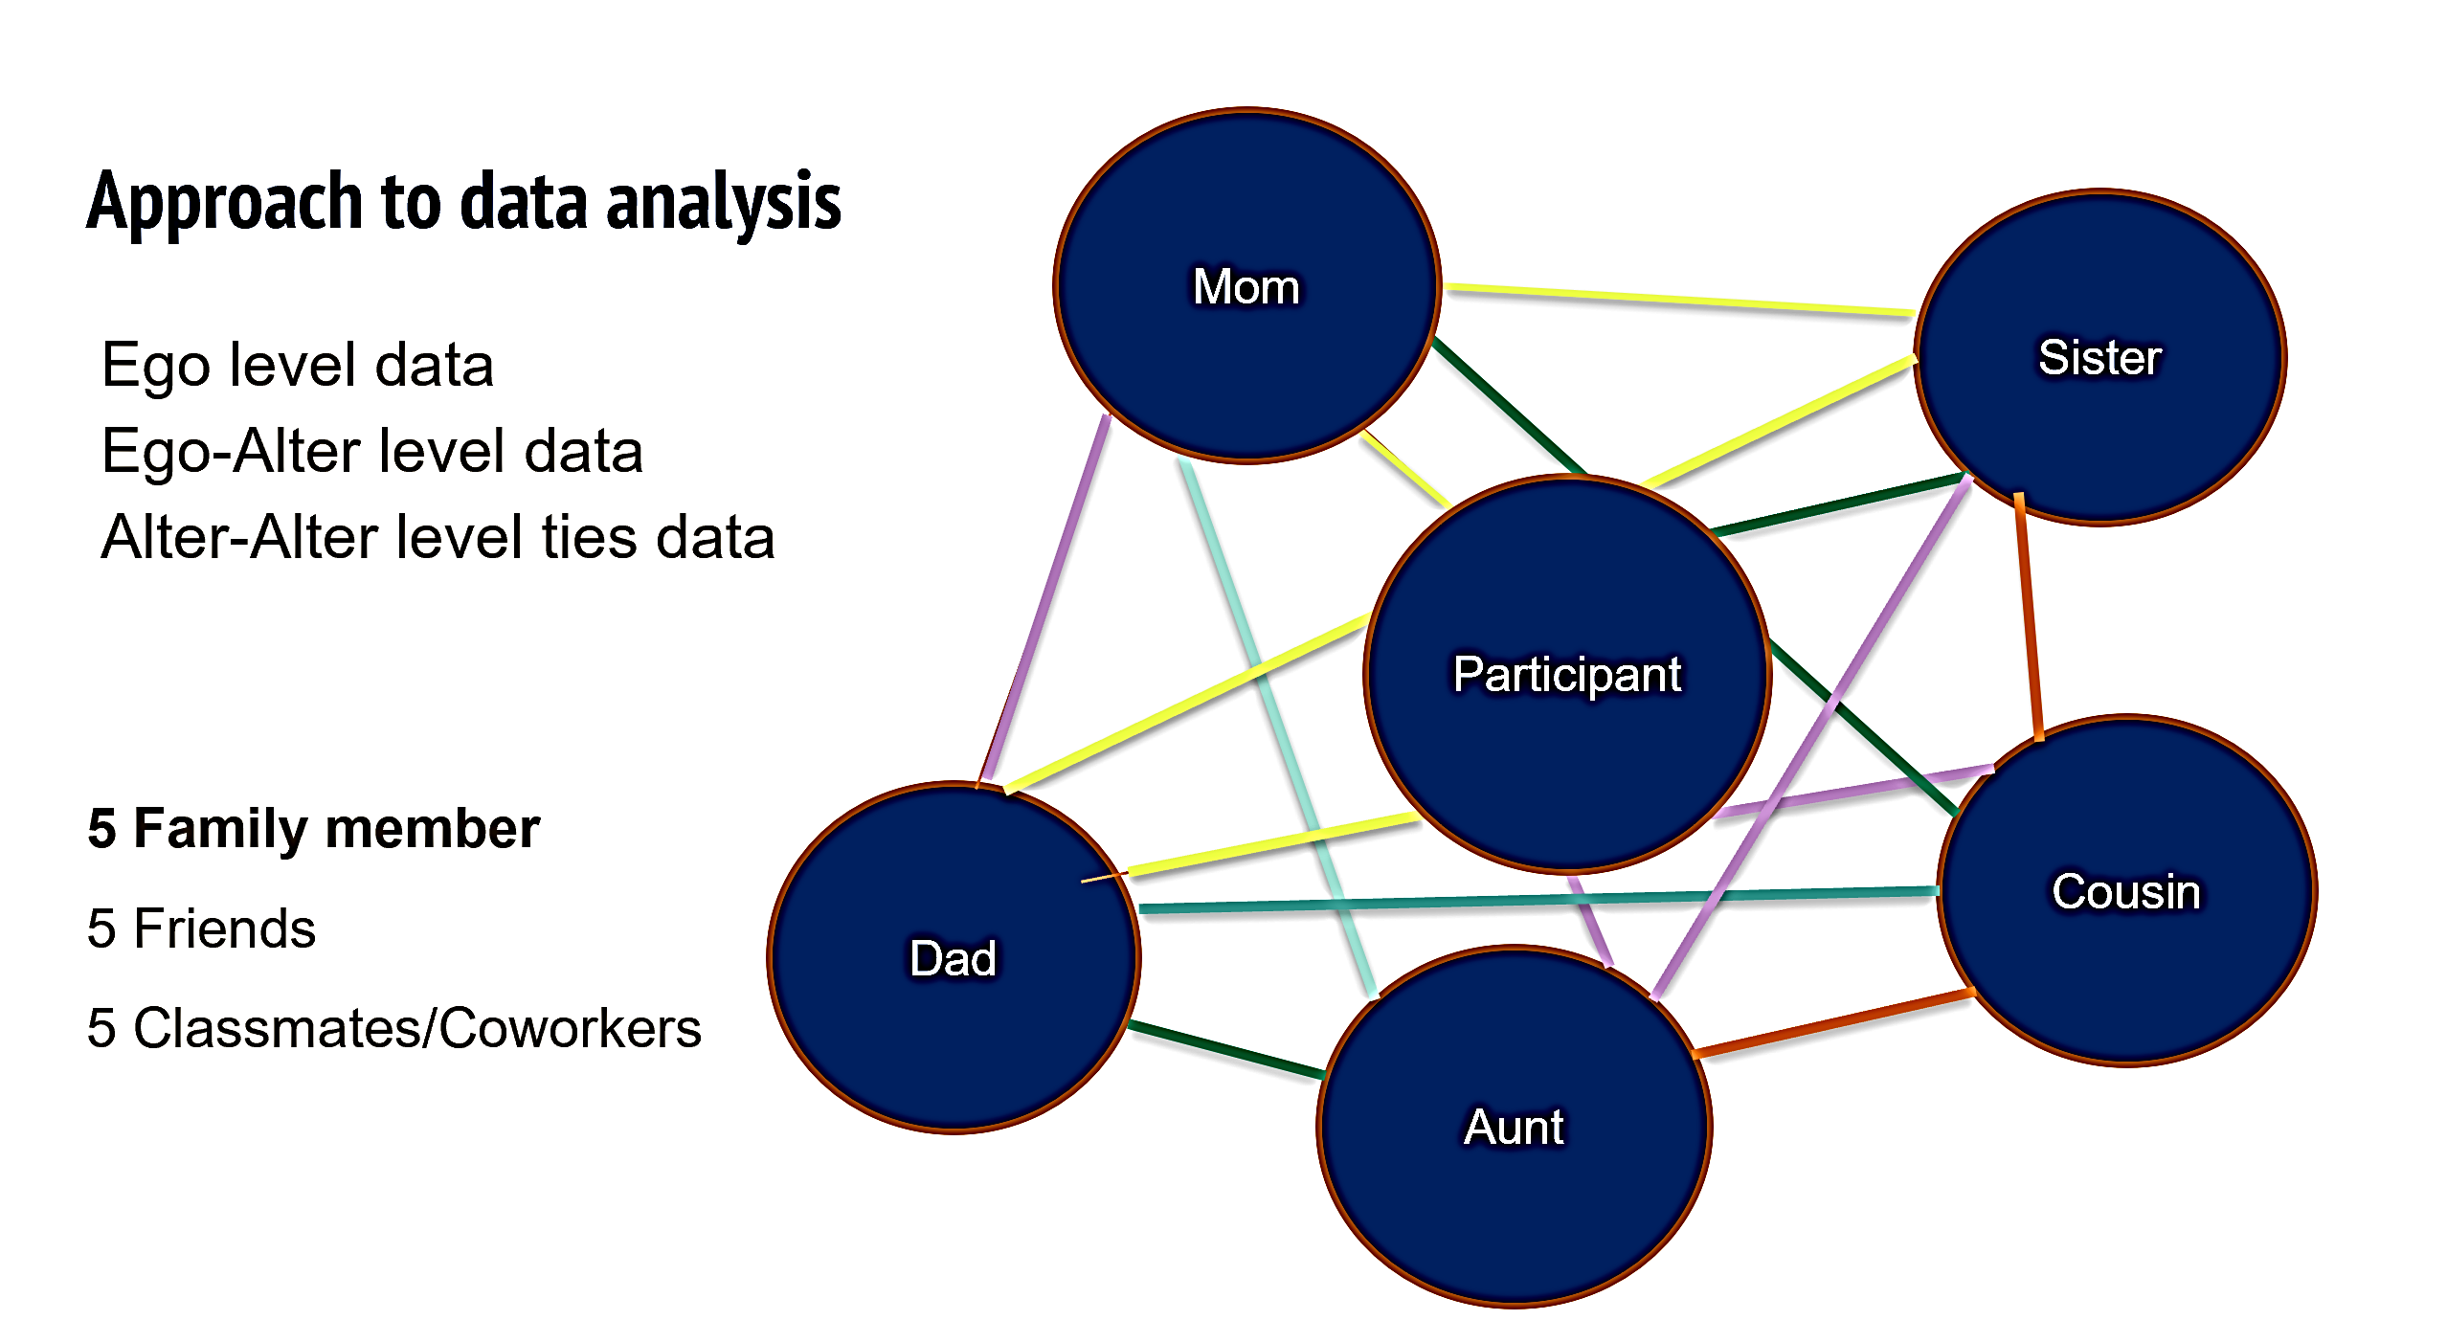
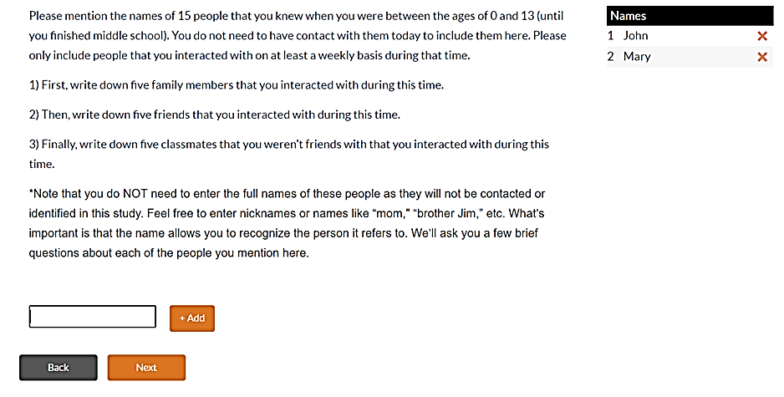
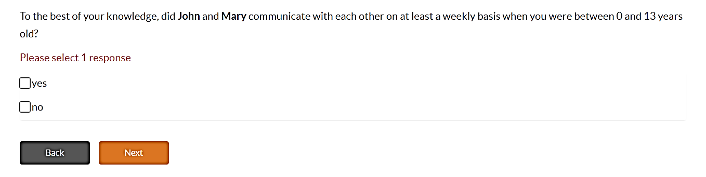
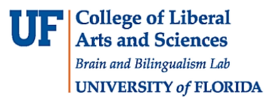
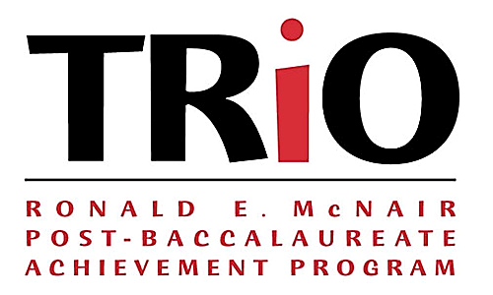
Personal Network Analysis Across Bilinguals Lifespan:
Relationships and Use of Language
Cabrera Perez, R.; Navarro, E.; Cañarte, D.; Rossi, E.
Department of Linguistics | College of Liberal Arts and Sciences
Introduction
Data Collection of Social Network
Methodology
The ability to communicate is a ubiquitous experience for humans from childhood to older age.
Social Network Analysis investigates the relationships that individuals have with other people in their lives [1].
Previous research on language acquisition has shown how crucial a diverse social network is for a bilingual or multilingual speaker.
Recent research has attempted to describe the variability of the bilingual experience through measures of language entropy [2], [3] to characterize individual differences in bi/multilinguals, and their multifaceted social use.
We designed an experiment to investigate the relationships between bilingual language use and social use in different social settings, and over lifespan.
Ego web software via virtual Zoom meeting Social Network Questionnaire (SNQ)
Language History Questionnaire (LHQ)
Tatool software (Stroop, Flanker)
Participants are being recruited through community detection of various states (e.g. California, Florida, New Mexico, Texas)
Requirement: Acquired both languages (English/Spanish) before the age of 7.
Observational Trends
1) Stronger bilingual network early in life and a shift to a less dense bilingual network later in life.
2) The father figure has less regular communication with the EGO because he works and is not present in the household.
EGO: Individual being tested
ALTER: Individual from ego’s social network (family, friends, classmates)
Sample size: 52 (ongoing data collection)
References
Objectives
Eriksen, B. A.; Eriksen, C. W. (1974). Effects of noise letters upon identification of a target letter in a non- search task. Perception and Psychophysics. 16: 143–149. doi:10.3758/bf03203267. S2CID 12012872.
[2] Gullifer, Jason W., and Debra Titone. "Characterizing the social diversity of bilingualism using language entropy." Bilingualism: Language and Cognition 23, no. 2 (2020): 283-294.
[3] Tiv, M., Gullifer, J. W., Feng, R. Y., & Titone, D. (2020). Using network science to map what Montréal bilinguals talk about across languages and communicative contexts. Journal of Neurolinguistics, 56, 100913.
Stroop, J. R. (1935). Studies of interference in serial verbal reactions. Journal of Experimental Psychology, 18(6), 643–662.
[1] Vacca, Raffaele; McCarty, Christopher; Lubbers, Miranda J., Molina, José Luis. (2019). Conducting Personal Networks Research. A Practical Guide.
1) How bilinguals’ language use and the immediate social network of the speakers change over time.
2) How the speakers’ social network and language use changes in different life/use domains (i.e. family, friends, and work).
Email: rcabreraperez@ufl.edu

