Slide 1
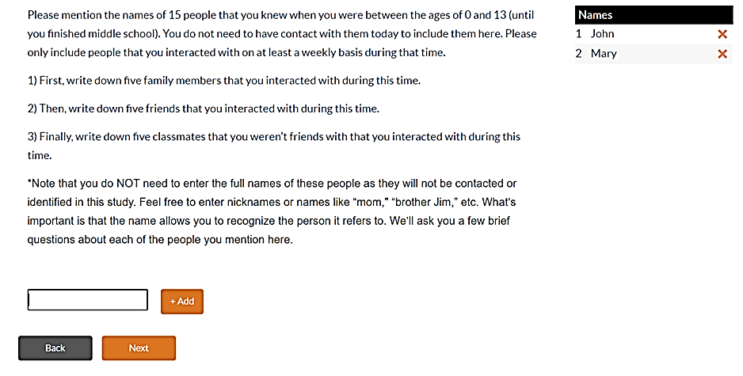
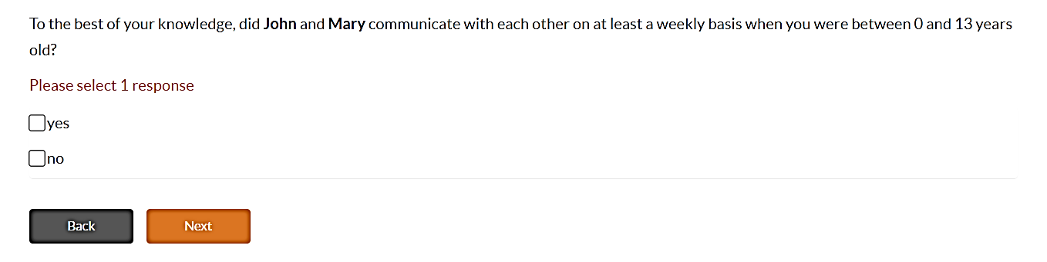
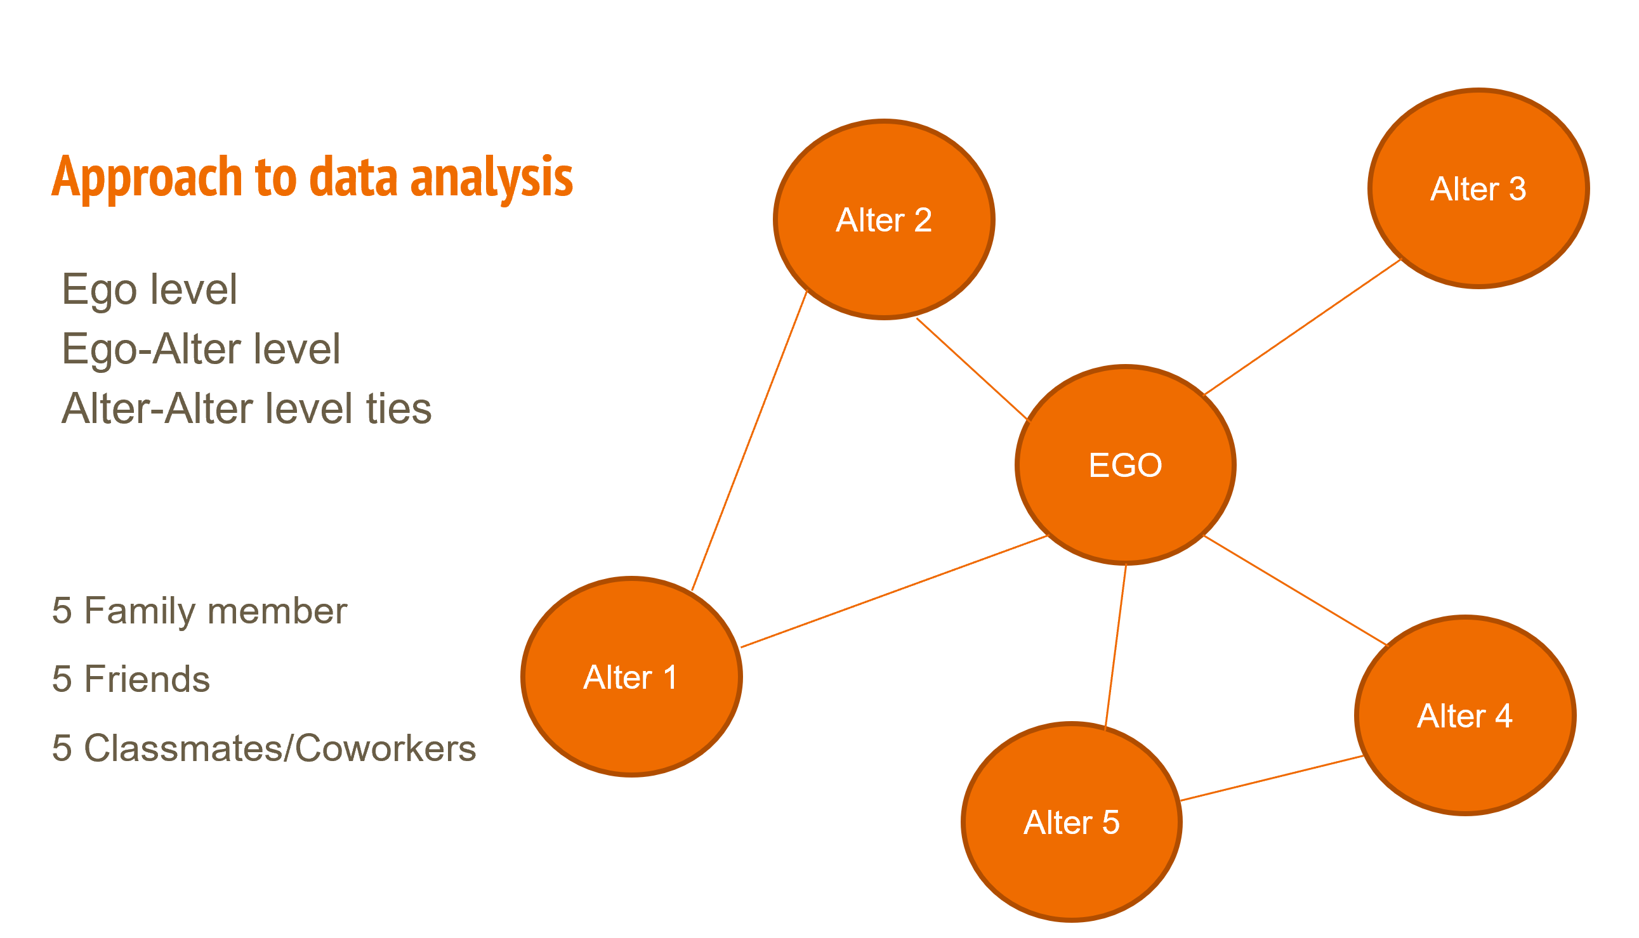
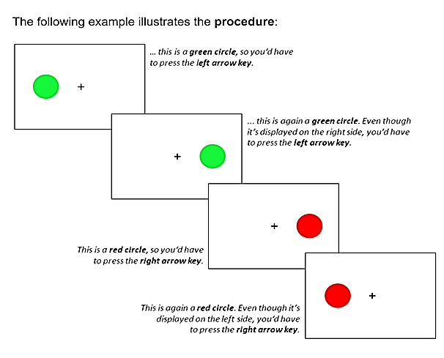
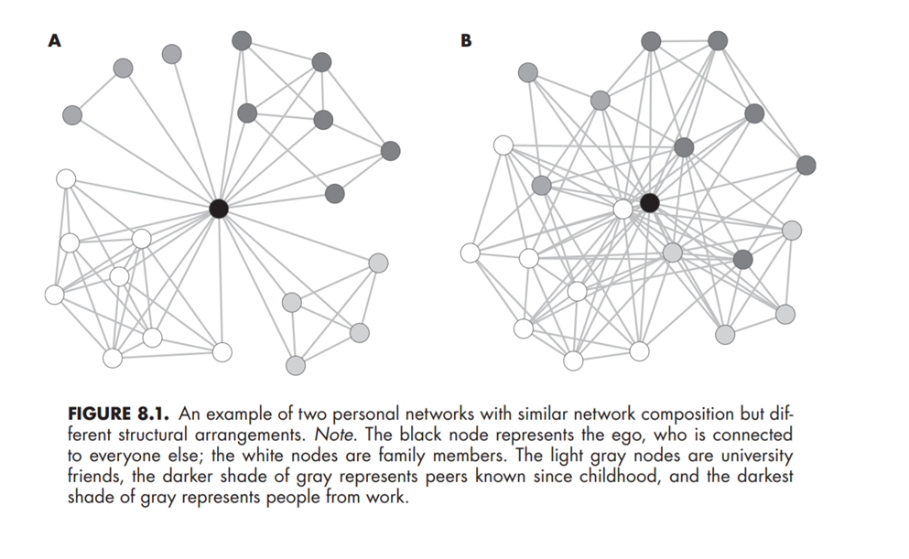
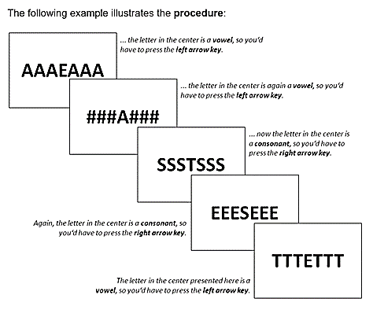
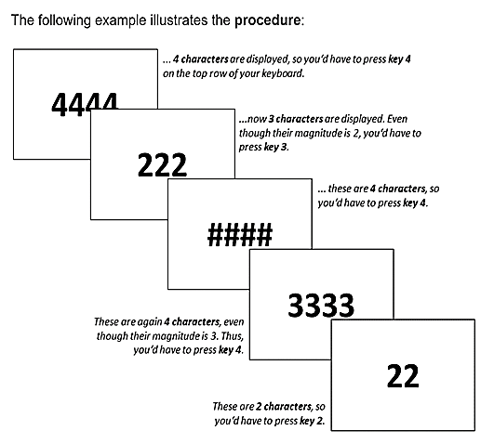


Social Network Analysis Across Bilinguals Lifespan
Cabrera Perez, R.; Navarro, E.; Cañarte, D.; Rossi, E.
Department of Linguistics | College of Liberal Arts and Sciences
INTRODUCTION
METHODS
DATA COLLECTION OF SOCIAL NETWORK
PRELIMINARY RESULTS
Social network analysis investigates the relationships that individuals have with the other people in their lives. The present study adds to the emerging area of research that investigates bilingualism through the lens of personal social networks [1,2]. We designed an experiment to investigate the relationships between bilingual language use and social use of the two languages in different social settings, and over lifespan with the goal to understand if language(s) use shapes individuals’ social networks. In this study we use a survey to investigate the social network features of bilingual Spanish-English speakers and understand how it correlates to a measure of cognitive control.
Ego web software via virtual Zoom meeting with participant.
2.5-3 hours long Social Network questionnaire.
Language History Questionnaire (LHQ)
Tatool software (Stroop, Flanker)
Participants are being recruited through community detection of various states predominantly populated by Hispanics.
States: California, Florida, New Mexico, Texas.
Nationalities: Cuba, D.R., Peru, Mexico, El Salvador, Honduras, Nicaragua, Puerto Rico, etc.)
Requirement: Acquired both languages (English/Spanish) before the age of seven. Must be 18-45 years old.
We are still collecting data from participants, and we have yet to analyze the data. We have noticed a general trend pertaining paterno-filial communication. The father figure does not have regular communication with participant alters because he works and is not present in the household. Another trend is a stronger bilingual network early in life and more use of English later in life. Also, we have noticed that participant’s social network is different depending on the geographical region in which they live.
REFERENCES
Eriksen, B. A.; Eriksen, C. W. (1974). Effects of noise letters upon identification of a target letter in a non- search task. Perception and Psychophysics. 16: 143–149. doi:10.3758/bf03203267. S2CID 12012872.
[1] Gullifer, Jason W., and Debra Titone. "Characterizing the social diversity of bilingualism using language entropy." Bilingualism: Language and Cognition 23, no. 2 (2020): 283-294.
[2] Tiv, M., Gullifer, J. W., Feng, R. Y., & Titone, D. (2020). Using network science to map what Montréal bilinguals talk about across languages and communicative contexts. Journal of Neurolinguistics, 56, 100913.
Stroop, J. R. (1935). Studies of interference in serial verbal reactions. Journal of Experimental Psychology, 18(6), 643–662.
OVERVIEW
We tested Spanish/English bilinguals who acquired both languages before the age of seven. During the social network interview, participants provided the names and details about the linguistic interactions with people across the family, school, and professional domains during two different life ranges: 0-13 and 14-present. Additionally, participants completed a short battery of cognitive tasks (i.e., Stroop, Flanker) to assess their cognitive control. We hypothesized that larger network size and greater variety in language usage would be correlated with greater cognitive control capabilities. Preliminary data (N=40) suggest a trend in which bilinguals use both of their languages early in life and English more towards their second stage. The cognitive control tasks have yet to be analyzed.
COGNITIVE CONTROL TASK:
STROOP & FLANKER
EGO: Individual being tested
ALTER: Individual from ego’s social network(family, friend, classmate)
ACKNOWLEDGEMENT & CONTACT
Thank you to Dr. Eleonora E. Rossi for giving me this great opportunity to being part of this project.
Questions about the project?
Email me at rcabreraperez@ufl.edu
This how a social network looks like after naming all alters. Image taken from Vacca, et al. 2019
GOALS
Capture how bilinguals' language use changes over time.
How bilinguals’ social network develops in terms of external and internal demands.

