Slide 1



Using social network analysis to understand bilingual language variation and cognitive performance
Cabrera-Perez, R.; Navarro, E.; Duarte, D.; Rossi, E

Slide 2
Background
Social network analysis investigates the relationships that individuals have with the other people in their lives. The present study adds to the emerging area of research that investigates bilingualism through the lens of personal social networks. We designed an experiment to investigate the relationships between bilingual language use and social use of the two languages in different social settings, and over lifespan with the goal to understand if language(s) use shapes individuals’ social networks.

Slide 3
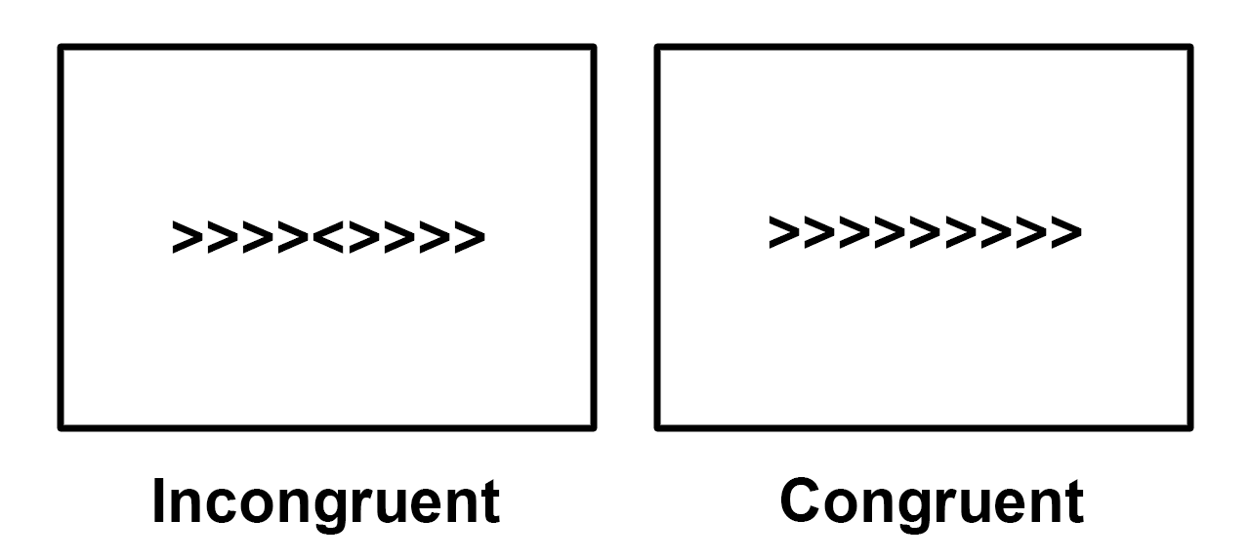
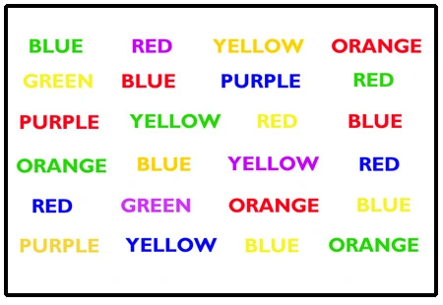
Purpose of the project
Using social network analysis to study bilingualism
  This is a new approach since bilinguals are not static
Looking at the participant’s language usage with different individuals across the lifespan
  0 - 13 years old, 14 years old - today
Includes cognitive control tasks as a dependent variable
  Stroop, Flanker

Slide 4
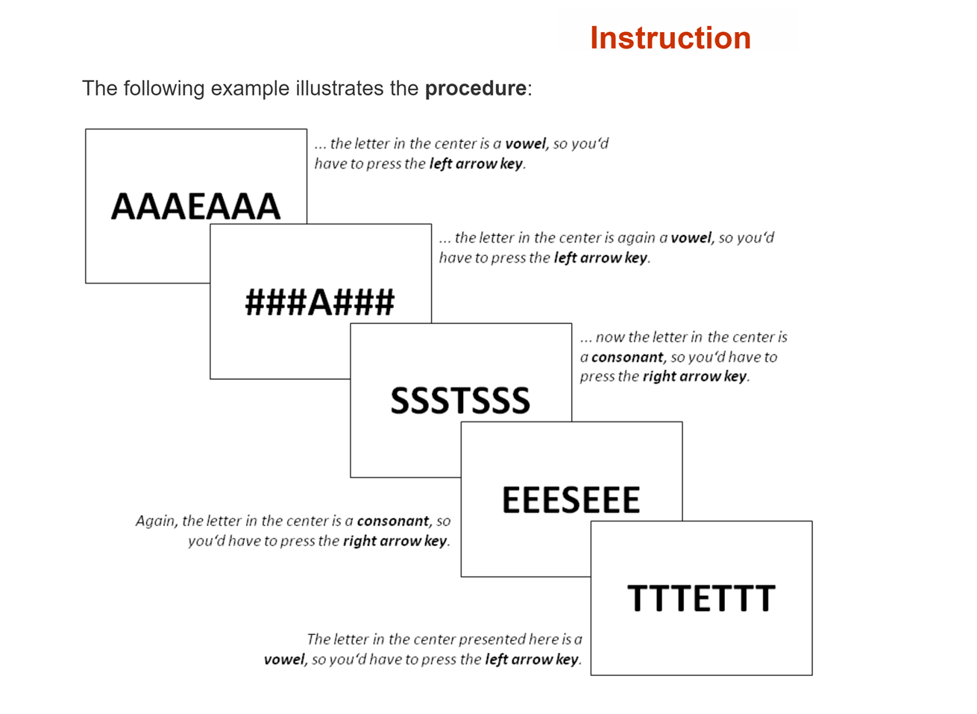
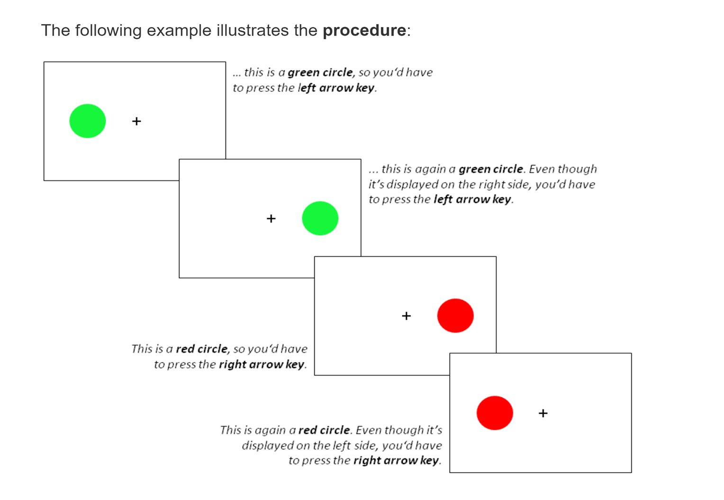
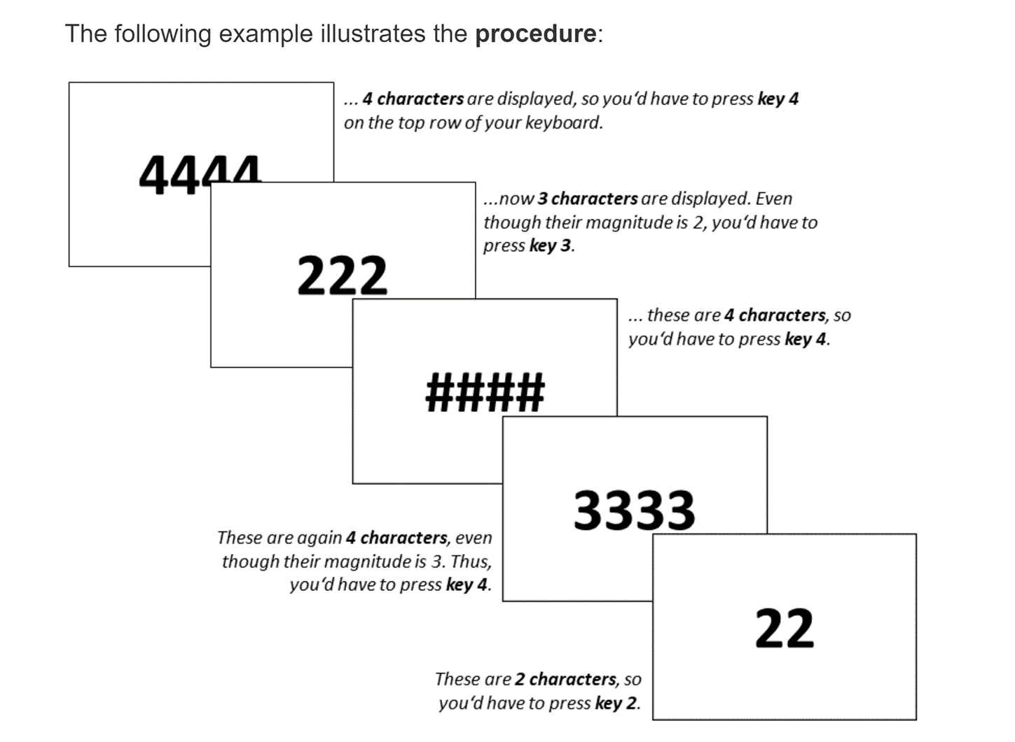

Slide 5
Methods
Egoweb software via virtual Zoom meeting with participant.
  2.5-3 hours long Social Network questionnaire.
Language History Questionnaire (LHQ)
Tatool software (Stroop, Flanker)
Participants are being recruited through community detection of various states predominantly populated by Hispanics.
  States: California, Florida, New Mexico, Texas.
  Various nationalities (Cuba, D.R, Peru, Mexico, El Salvador, Honduras, Nicaragua, Puerto Rico, etc.)
  Acquired both languages (English/Spanish) before the age of seven.

Slide 6
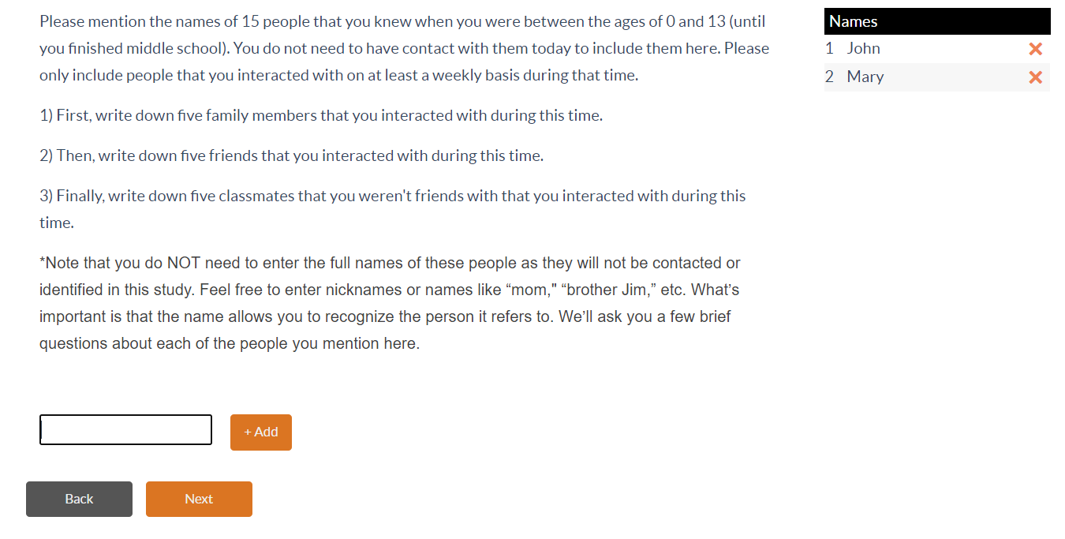
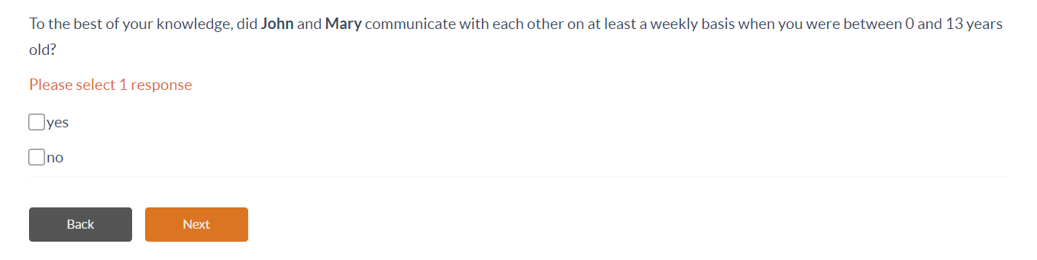
What we’ve done so far
EgoWeb data collection
  see pictures for examples of the platform
N = 40 Spanish/English bilinguals

Slide 7
Approach to data analysis
Mom
Sister
Ego level data
Ego-Alter level data
Alter-Alter level ties data
Participant
Cousin
5 Family member
5 Friends
5 Classmates/Coworkers
Dad
Aunt

Slide 8
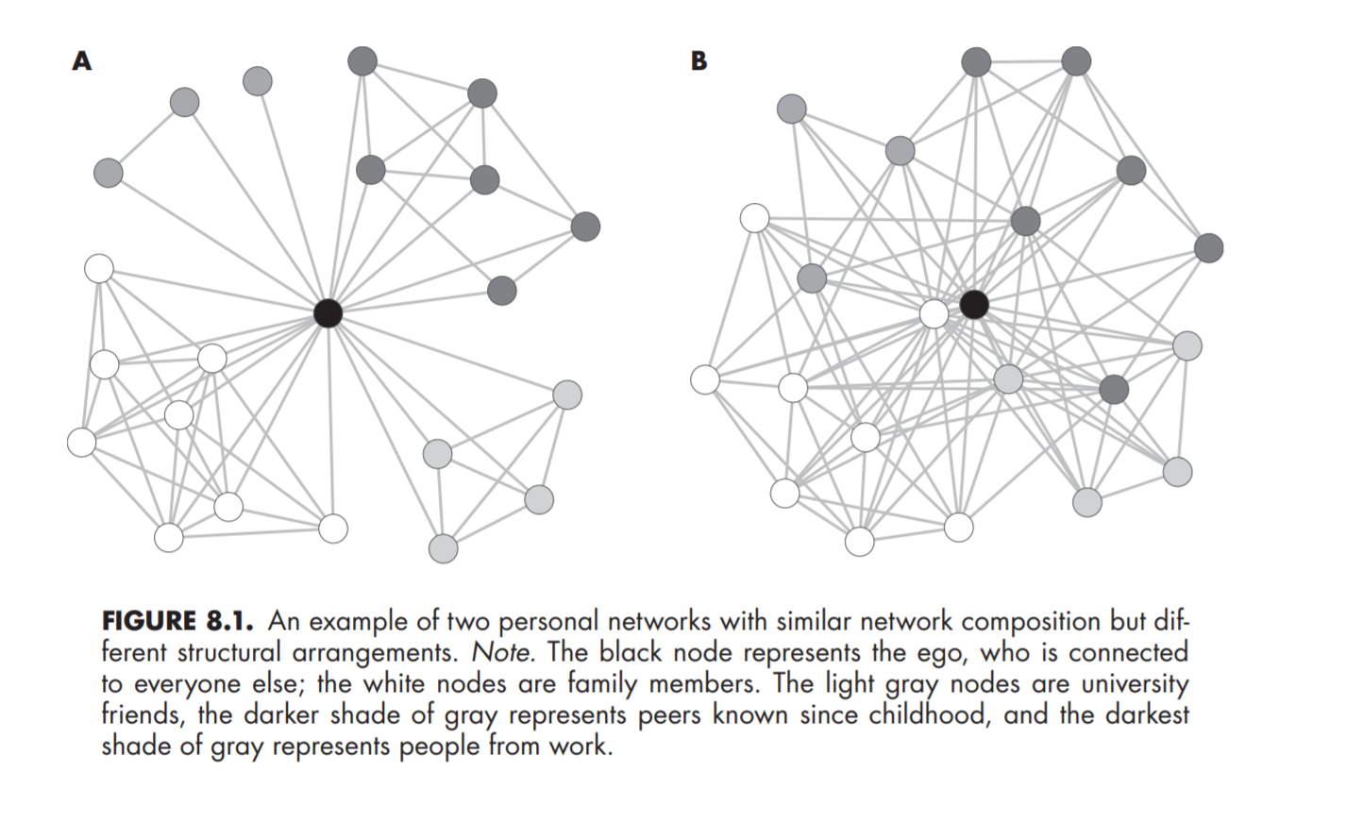
Personal Network
This how a Social Network is supposed to look after naming all alters.
Goals:
Capture how bilinguals' language use changes over time.
How bilinguals’ social network develops in terms of external and internal demands.
Vacca et al. (2018)

Slide 9
Results (preliminary results)
We are still collecting data from participants, and we have yet to analyze the data. We have noticed a general trend pertaining paterno-filial communication. The father figure does not have regular communication with participant alters because he works and is not present in the household. Another trend is a stronger bilingual network early in life and more use of English later in life. Also, we have noticed that participant’s social network is different depending on the area in which they live.

Slide 10
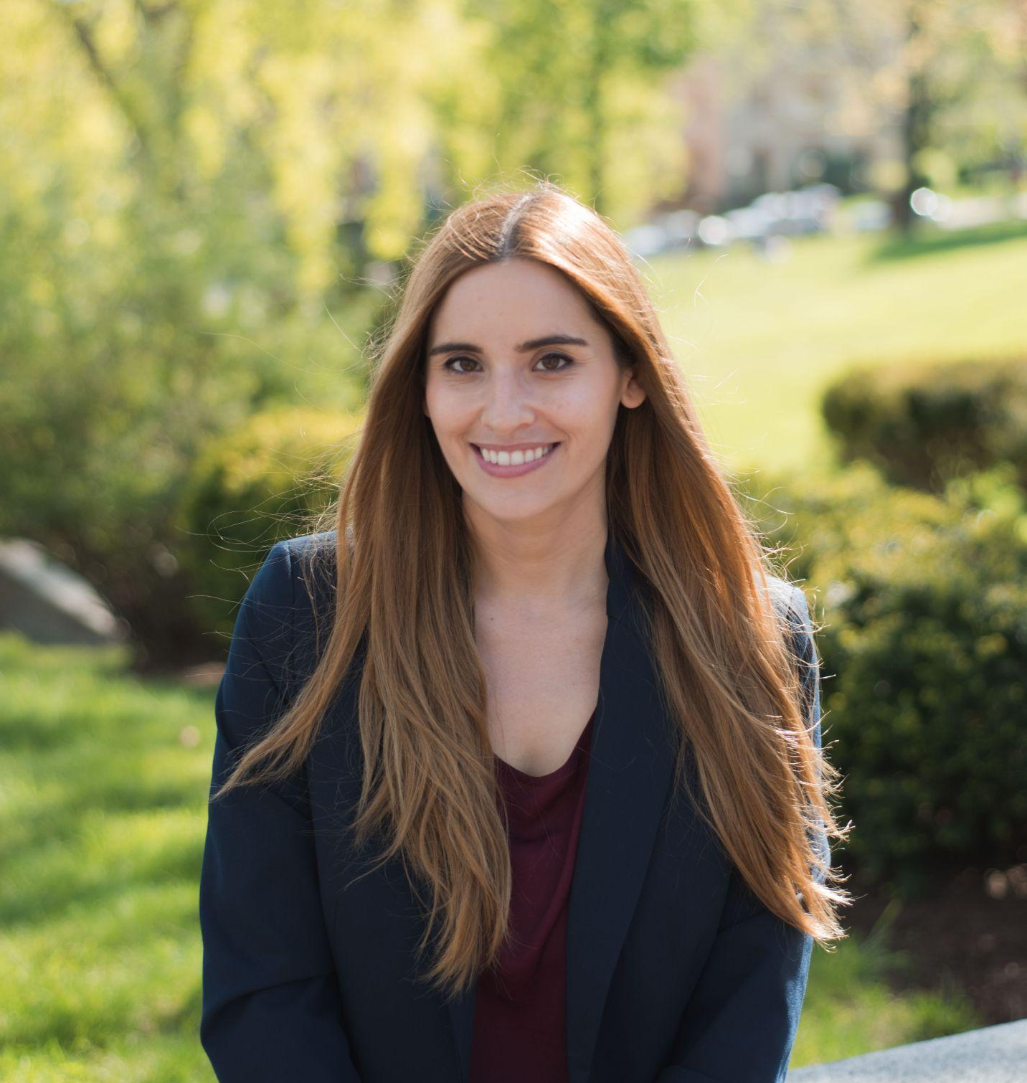

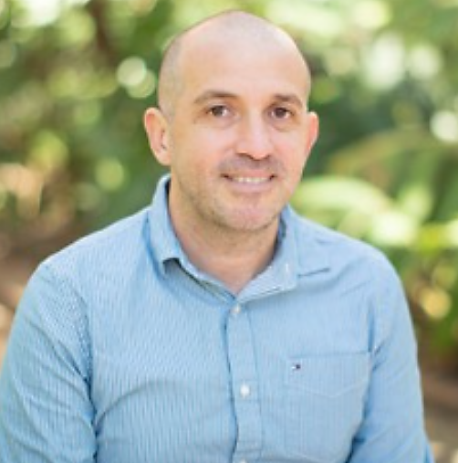
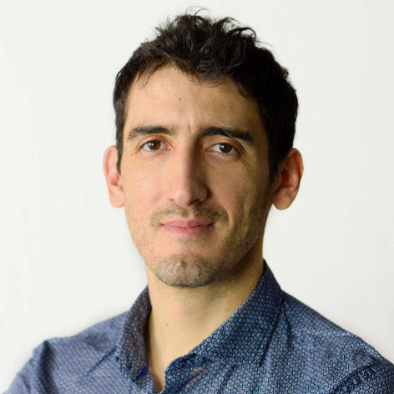
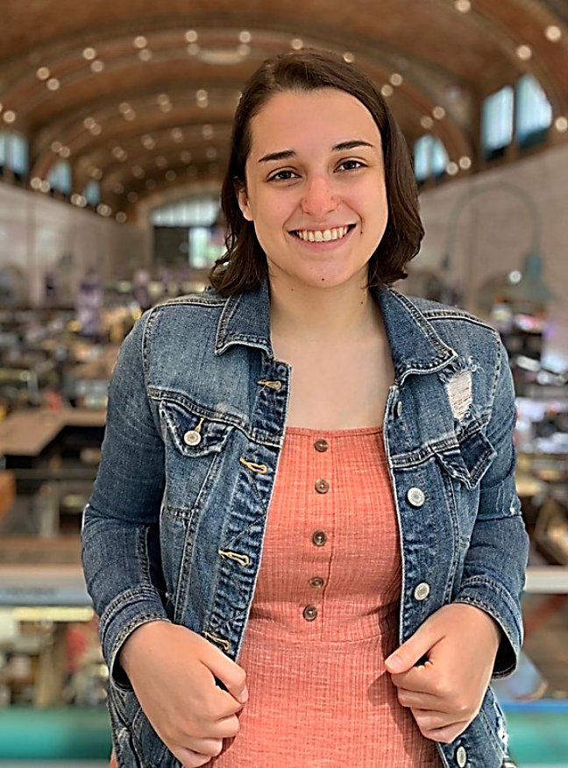
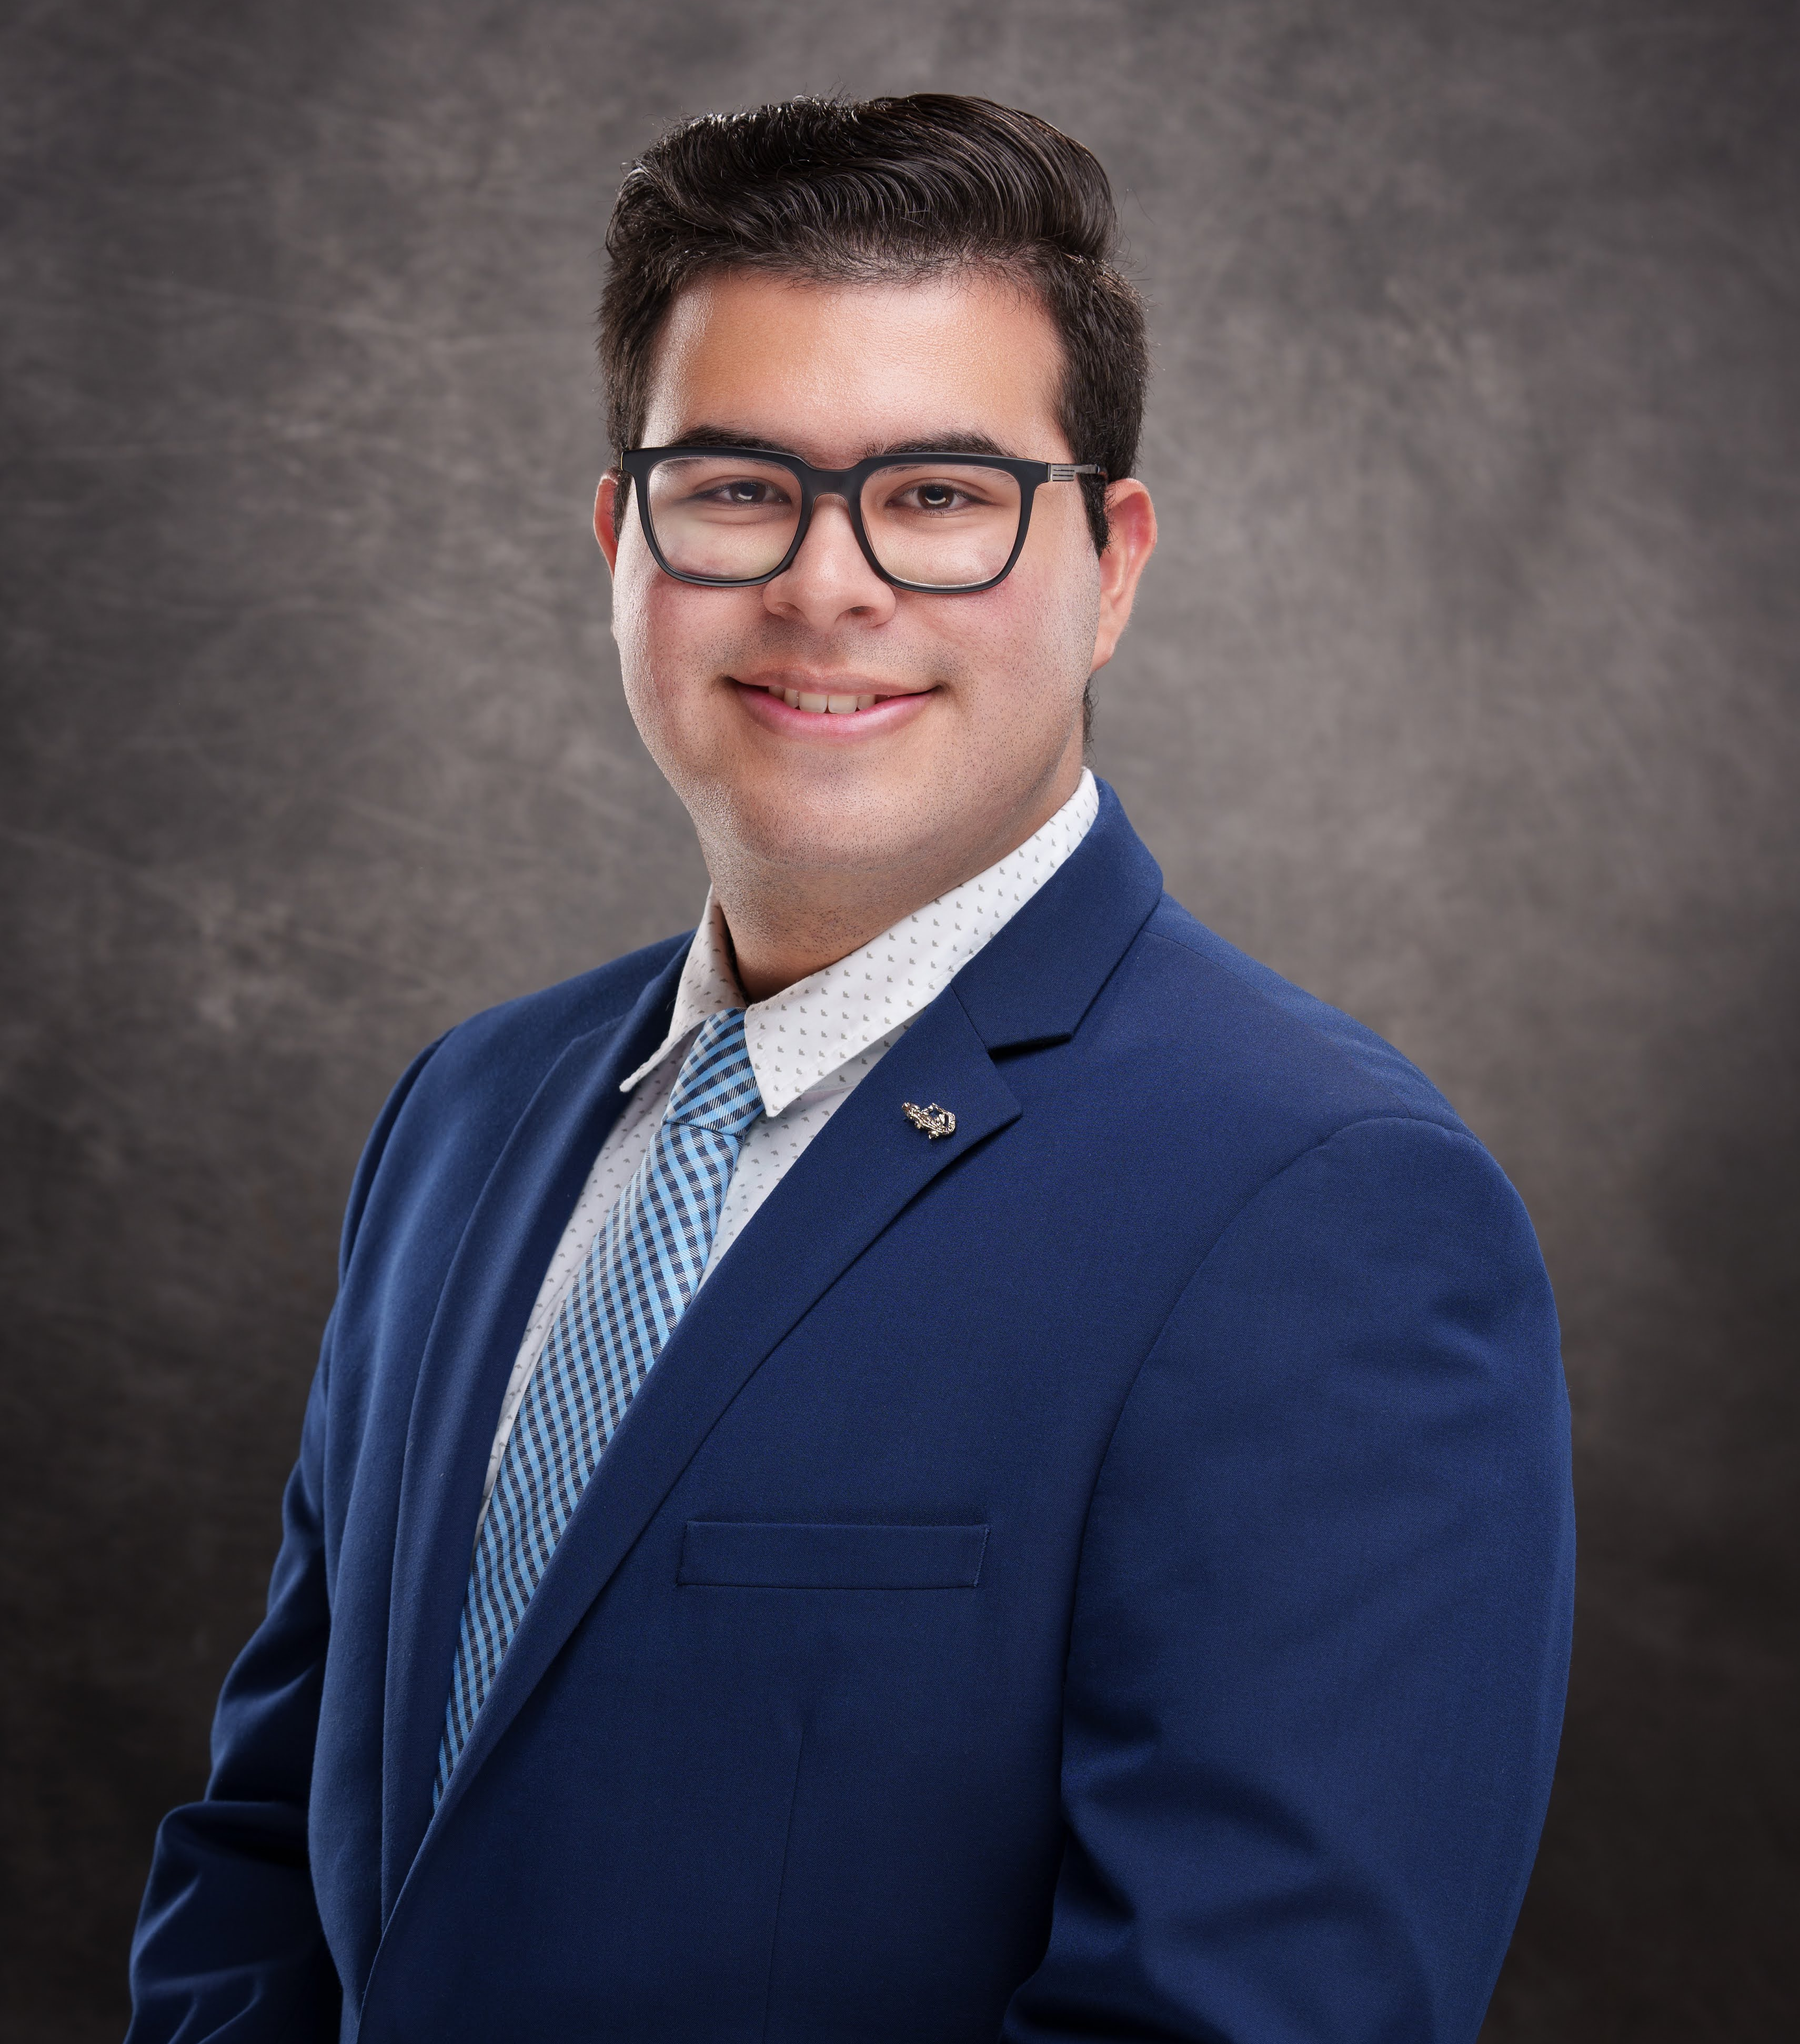

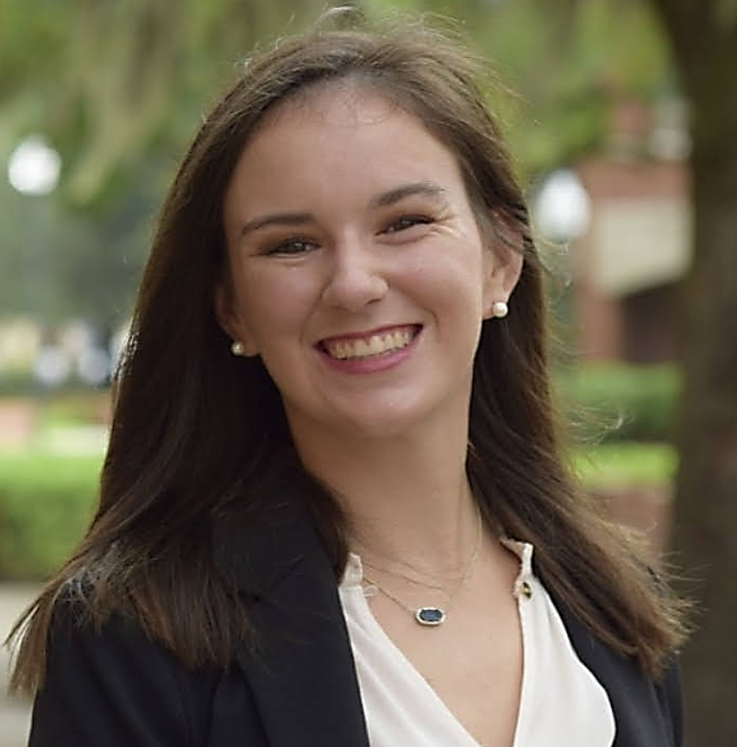
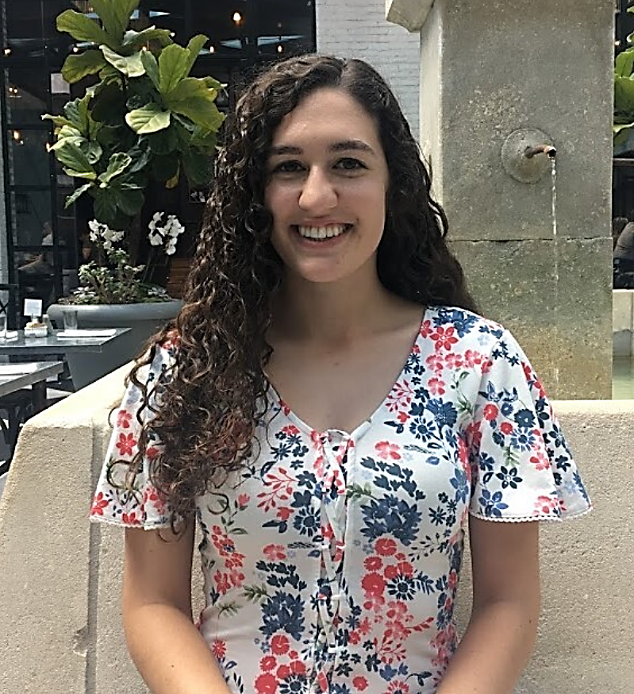

It takes a village!
Dr. Ester Navarro
Dr. Eleonora Rossi
Dr. David Cañarte
Dr. Raffaele Vacca
Elizabeth Troiano
Reinaldo Cabrera Pérez
Caroline Levine
Madelyn Kloske
Roxy Miltenberger
Sparsha Muralidhara

